Slide 1
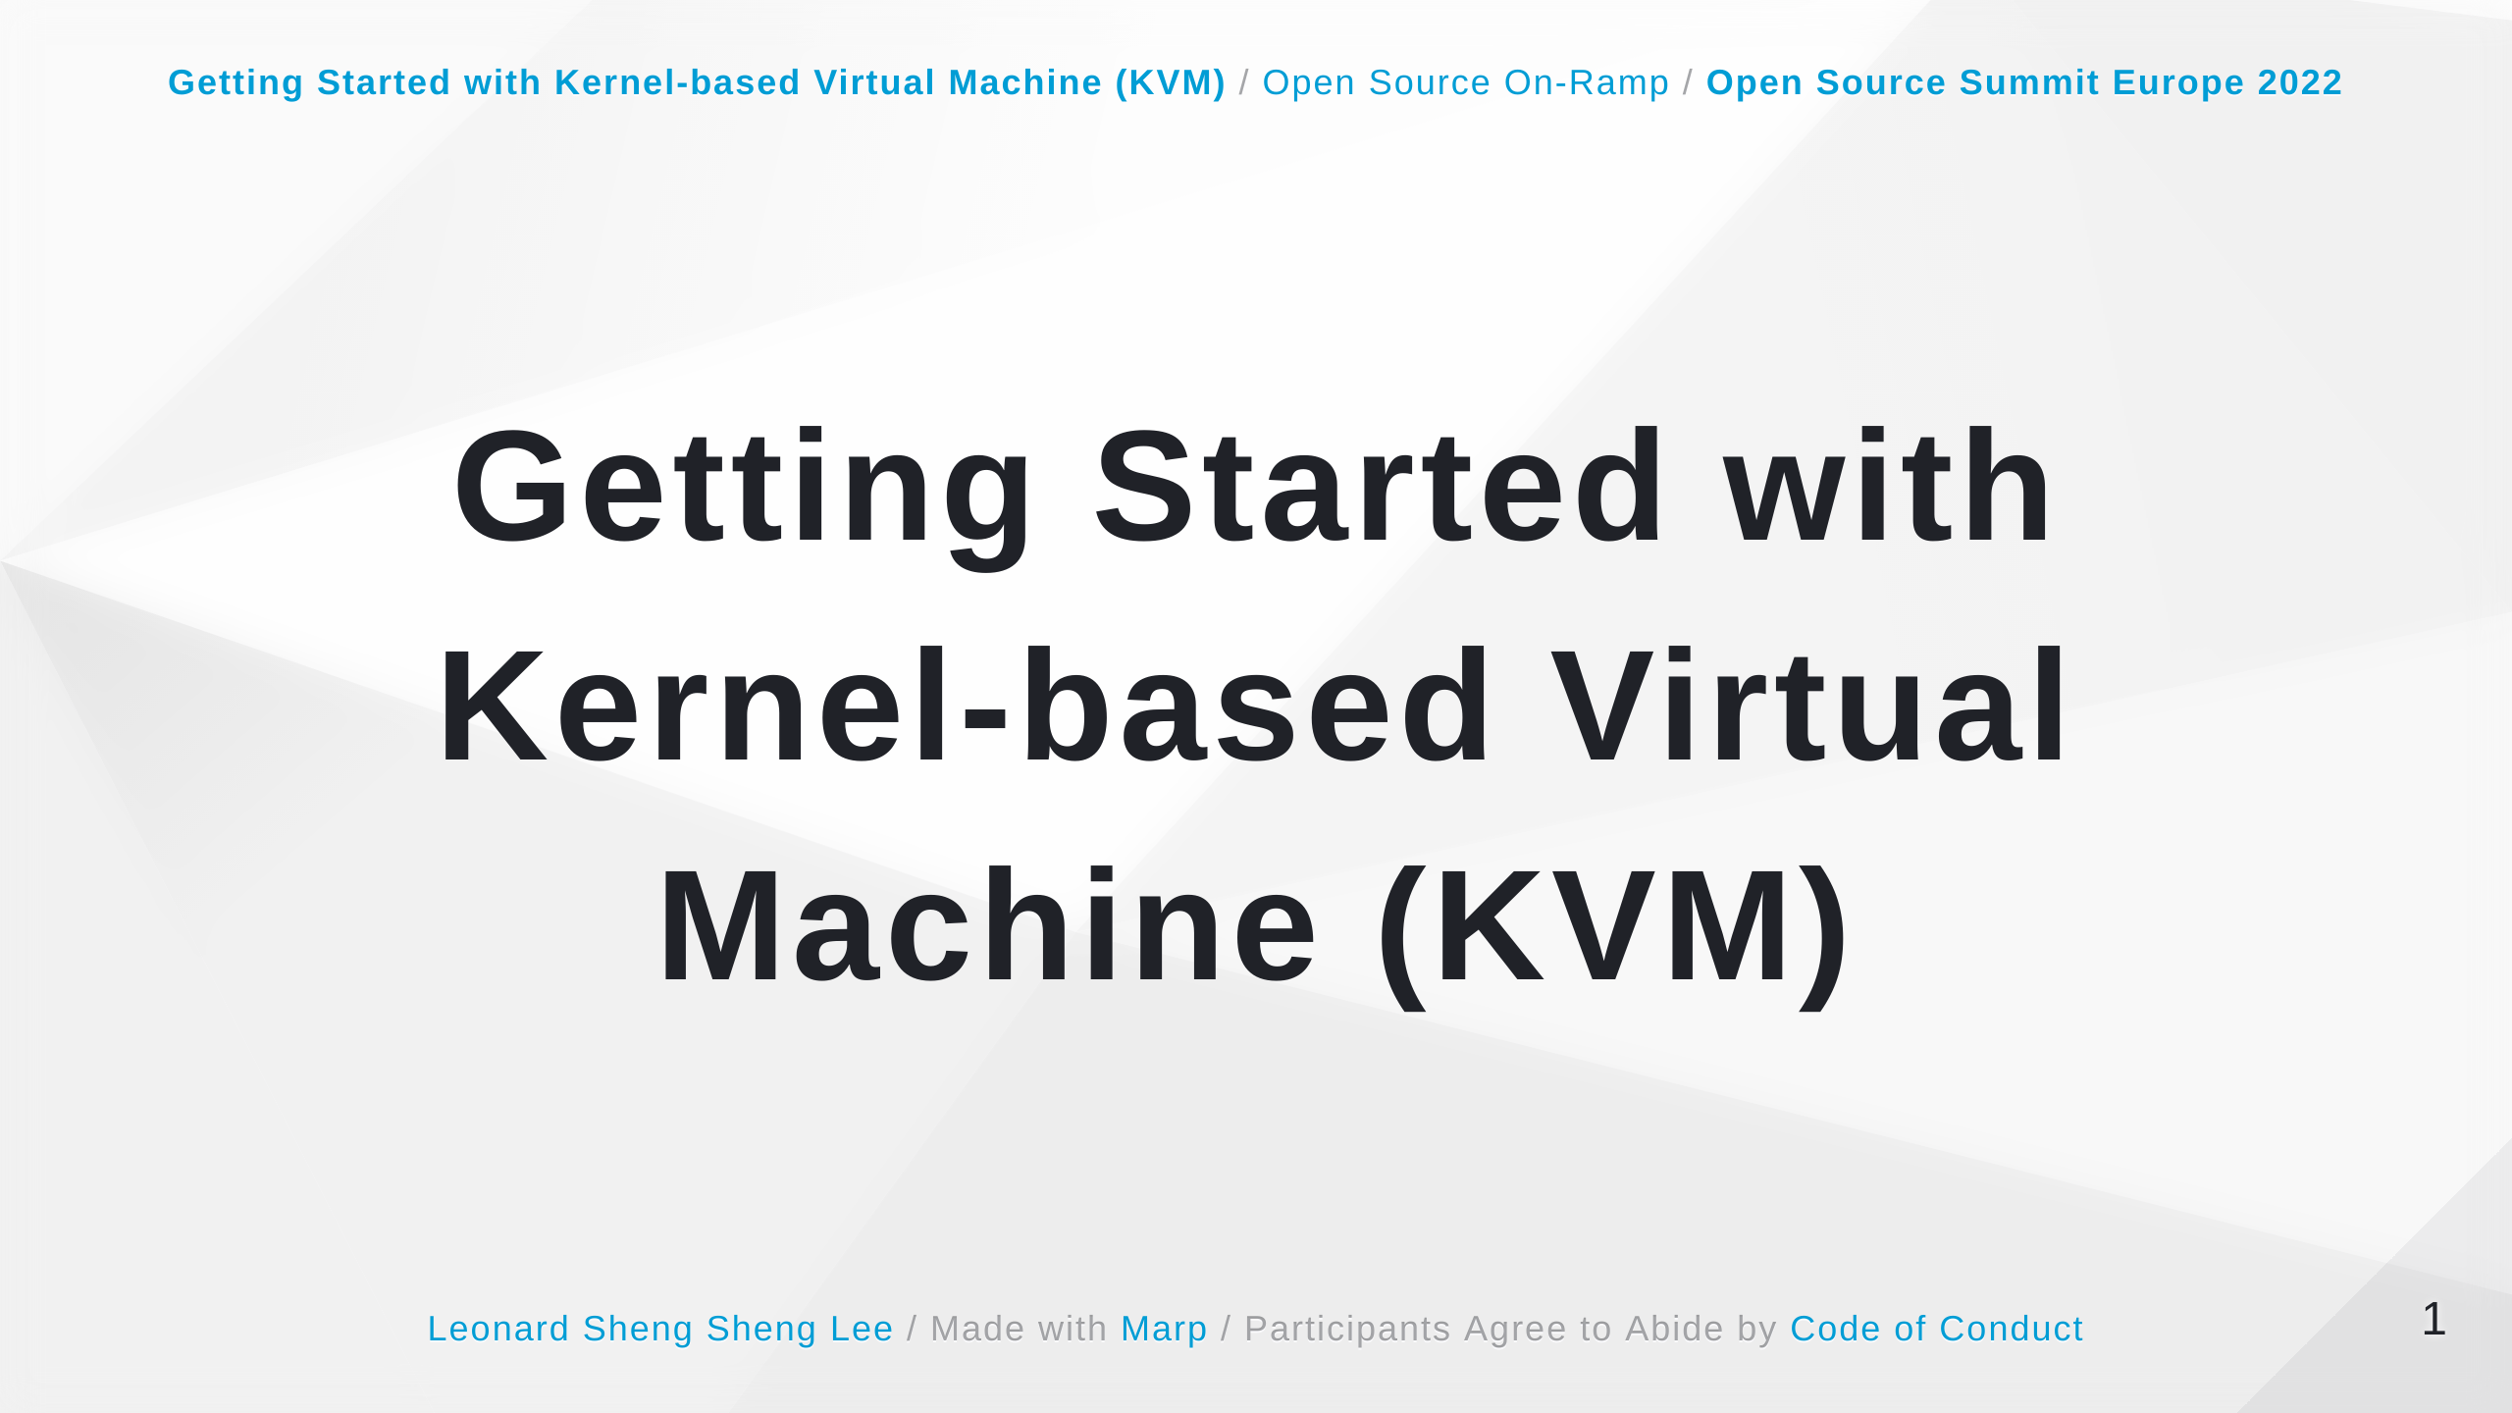

Slide 2
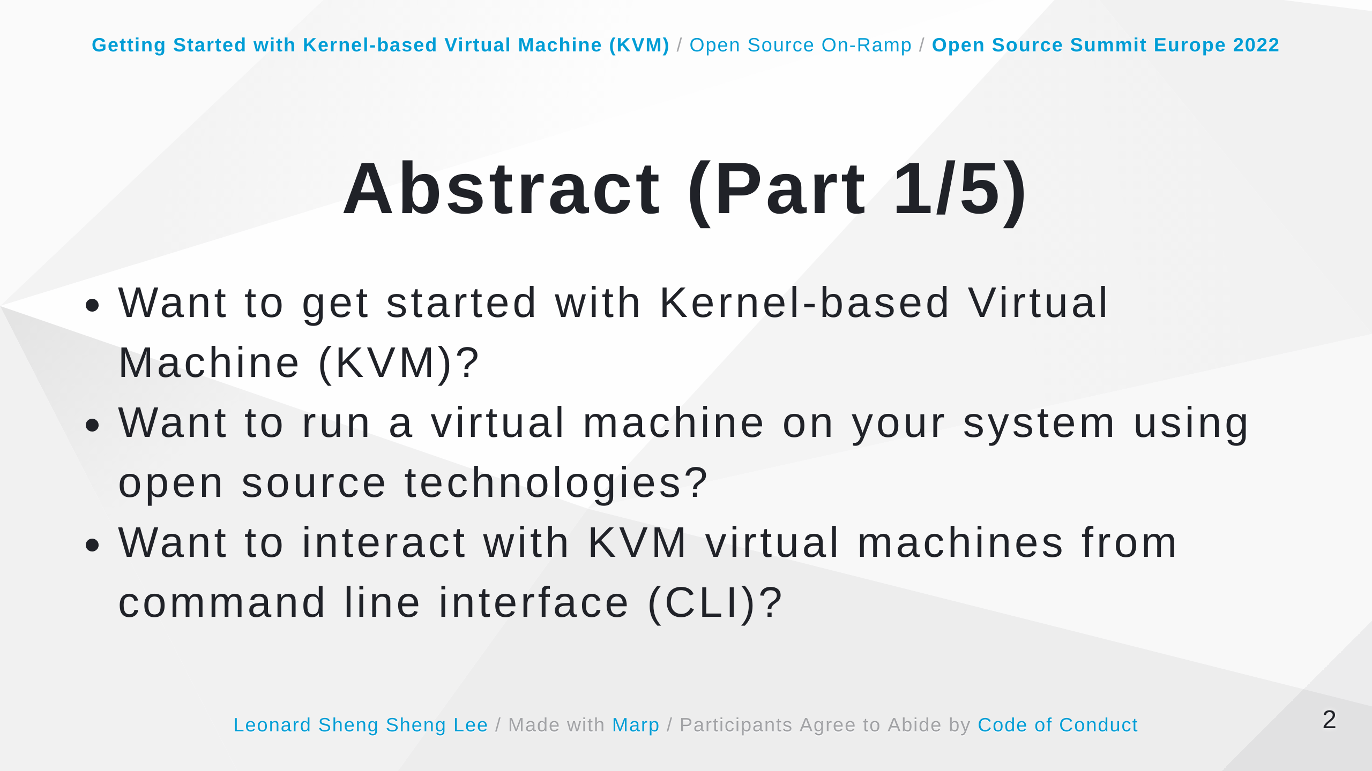

Slide 3
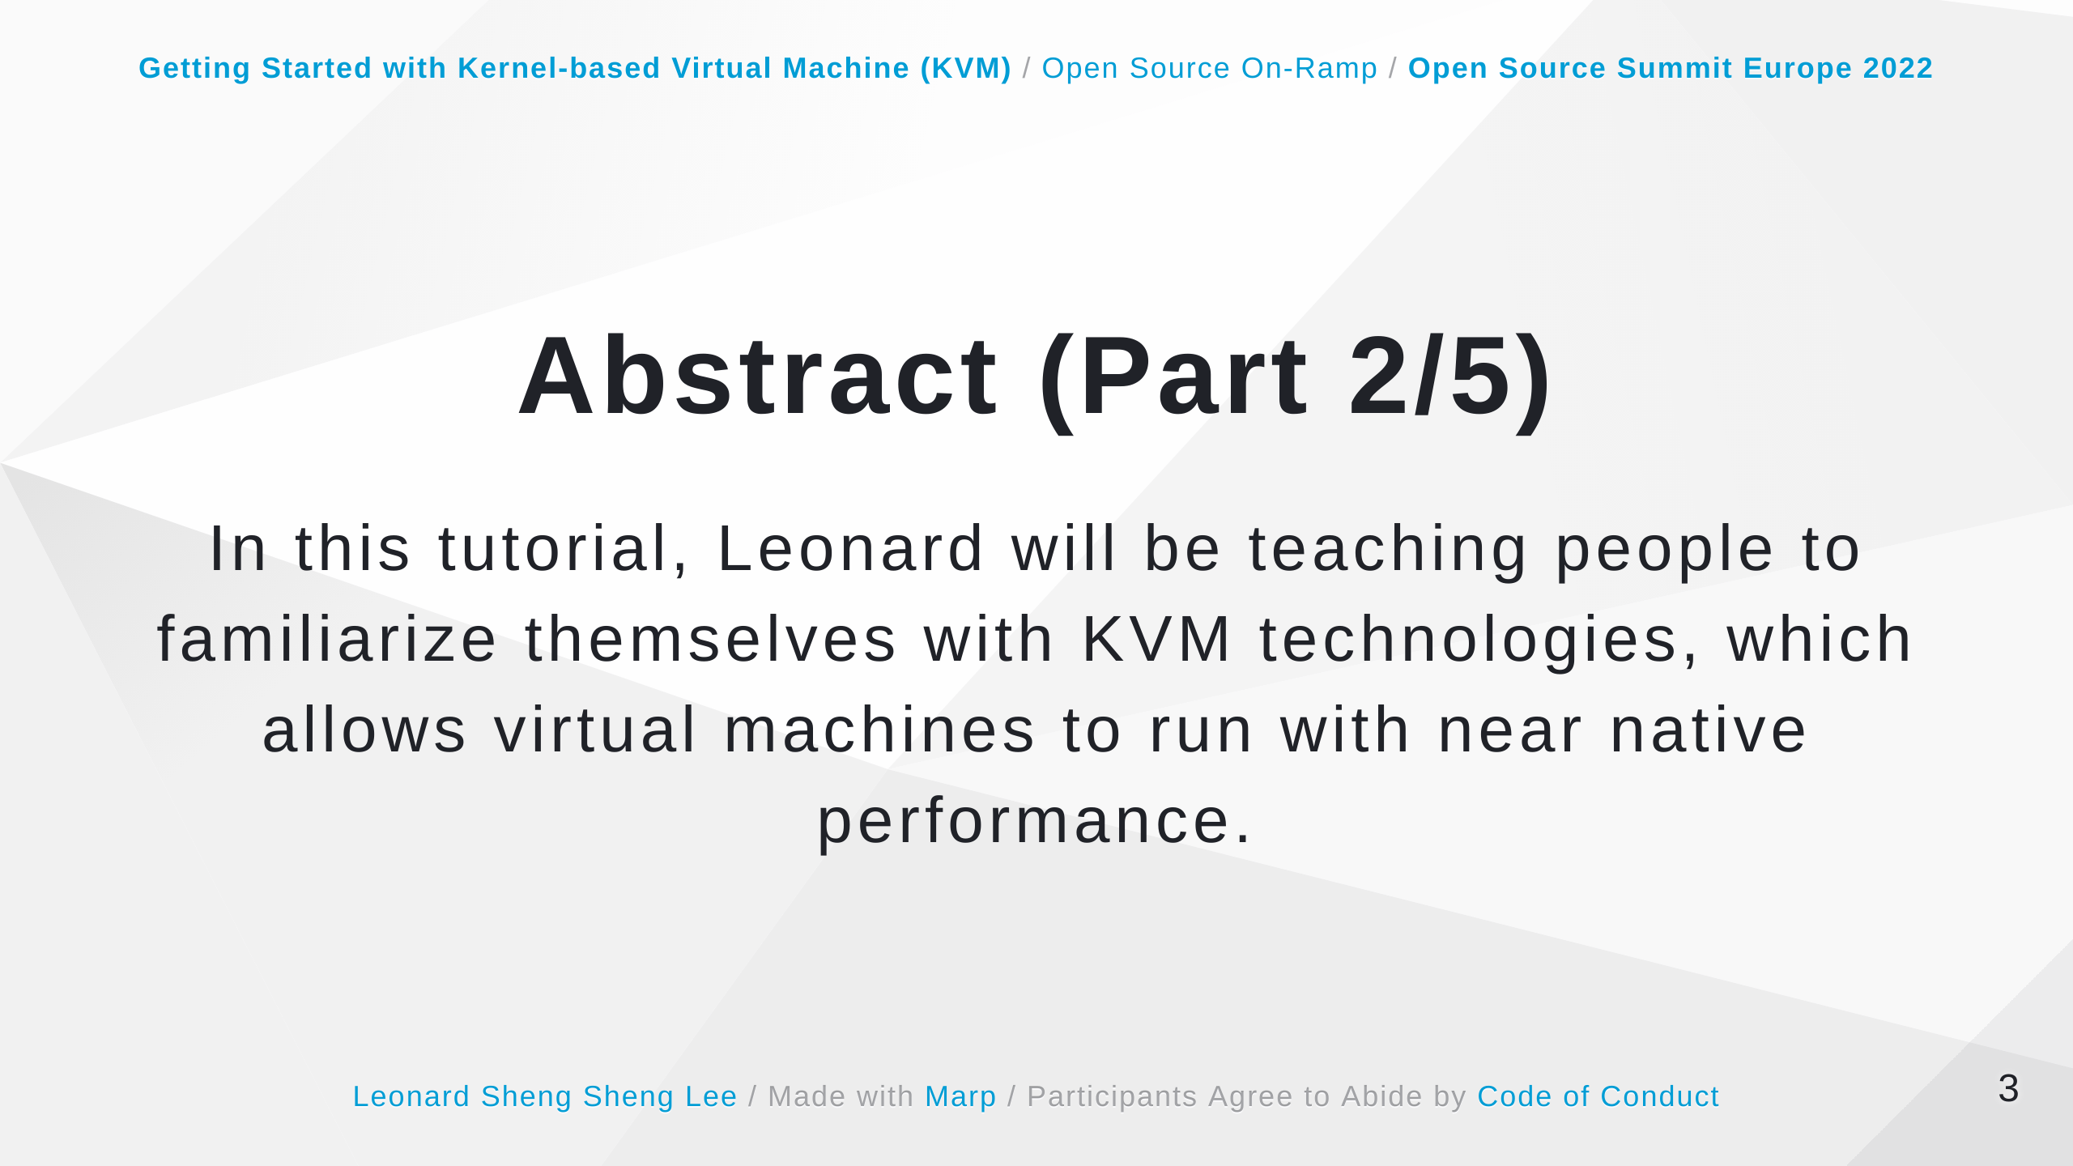

Slide 4
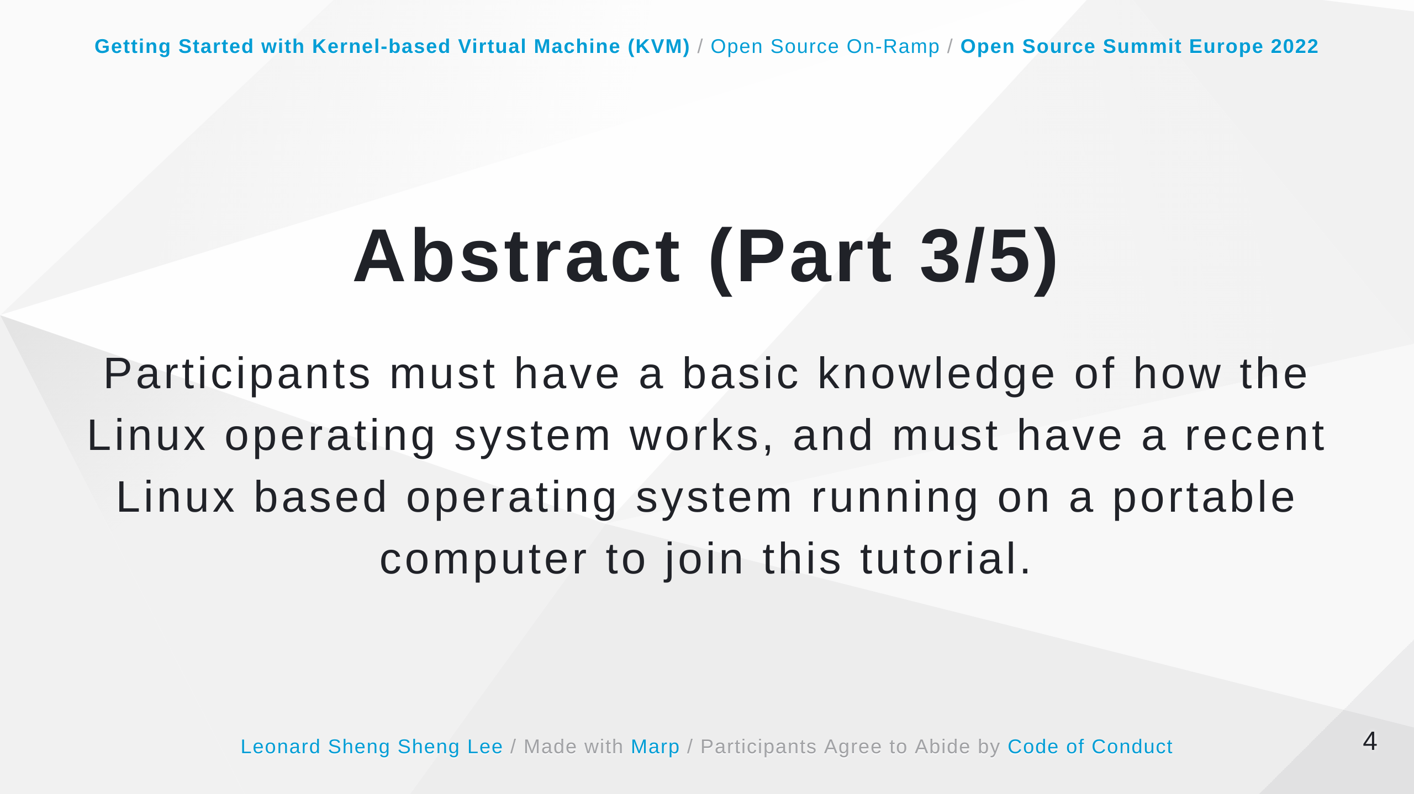

Slide 5
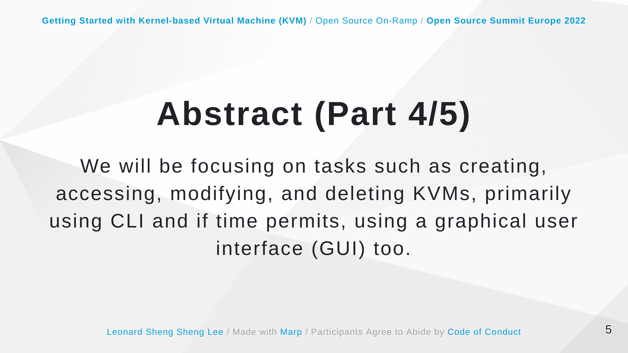

Slide 6
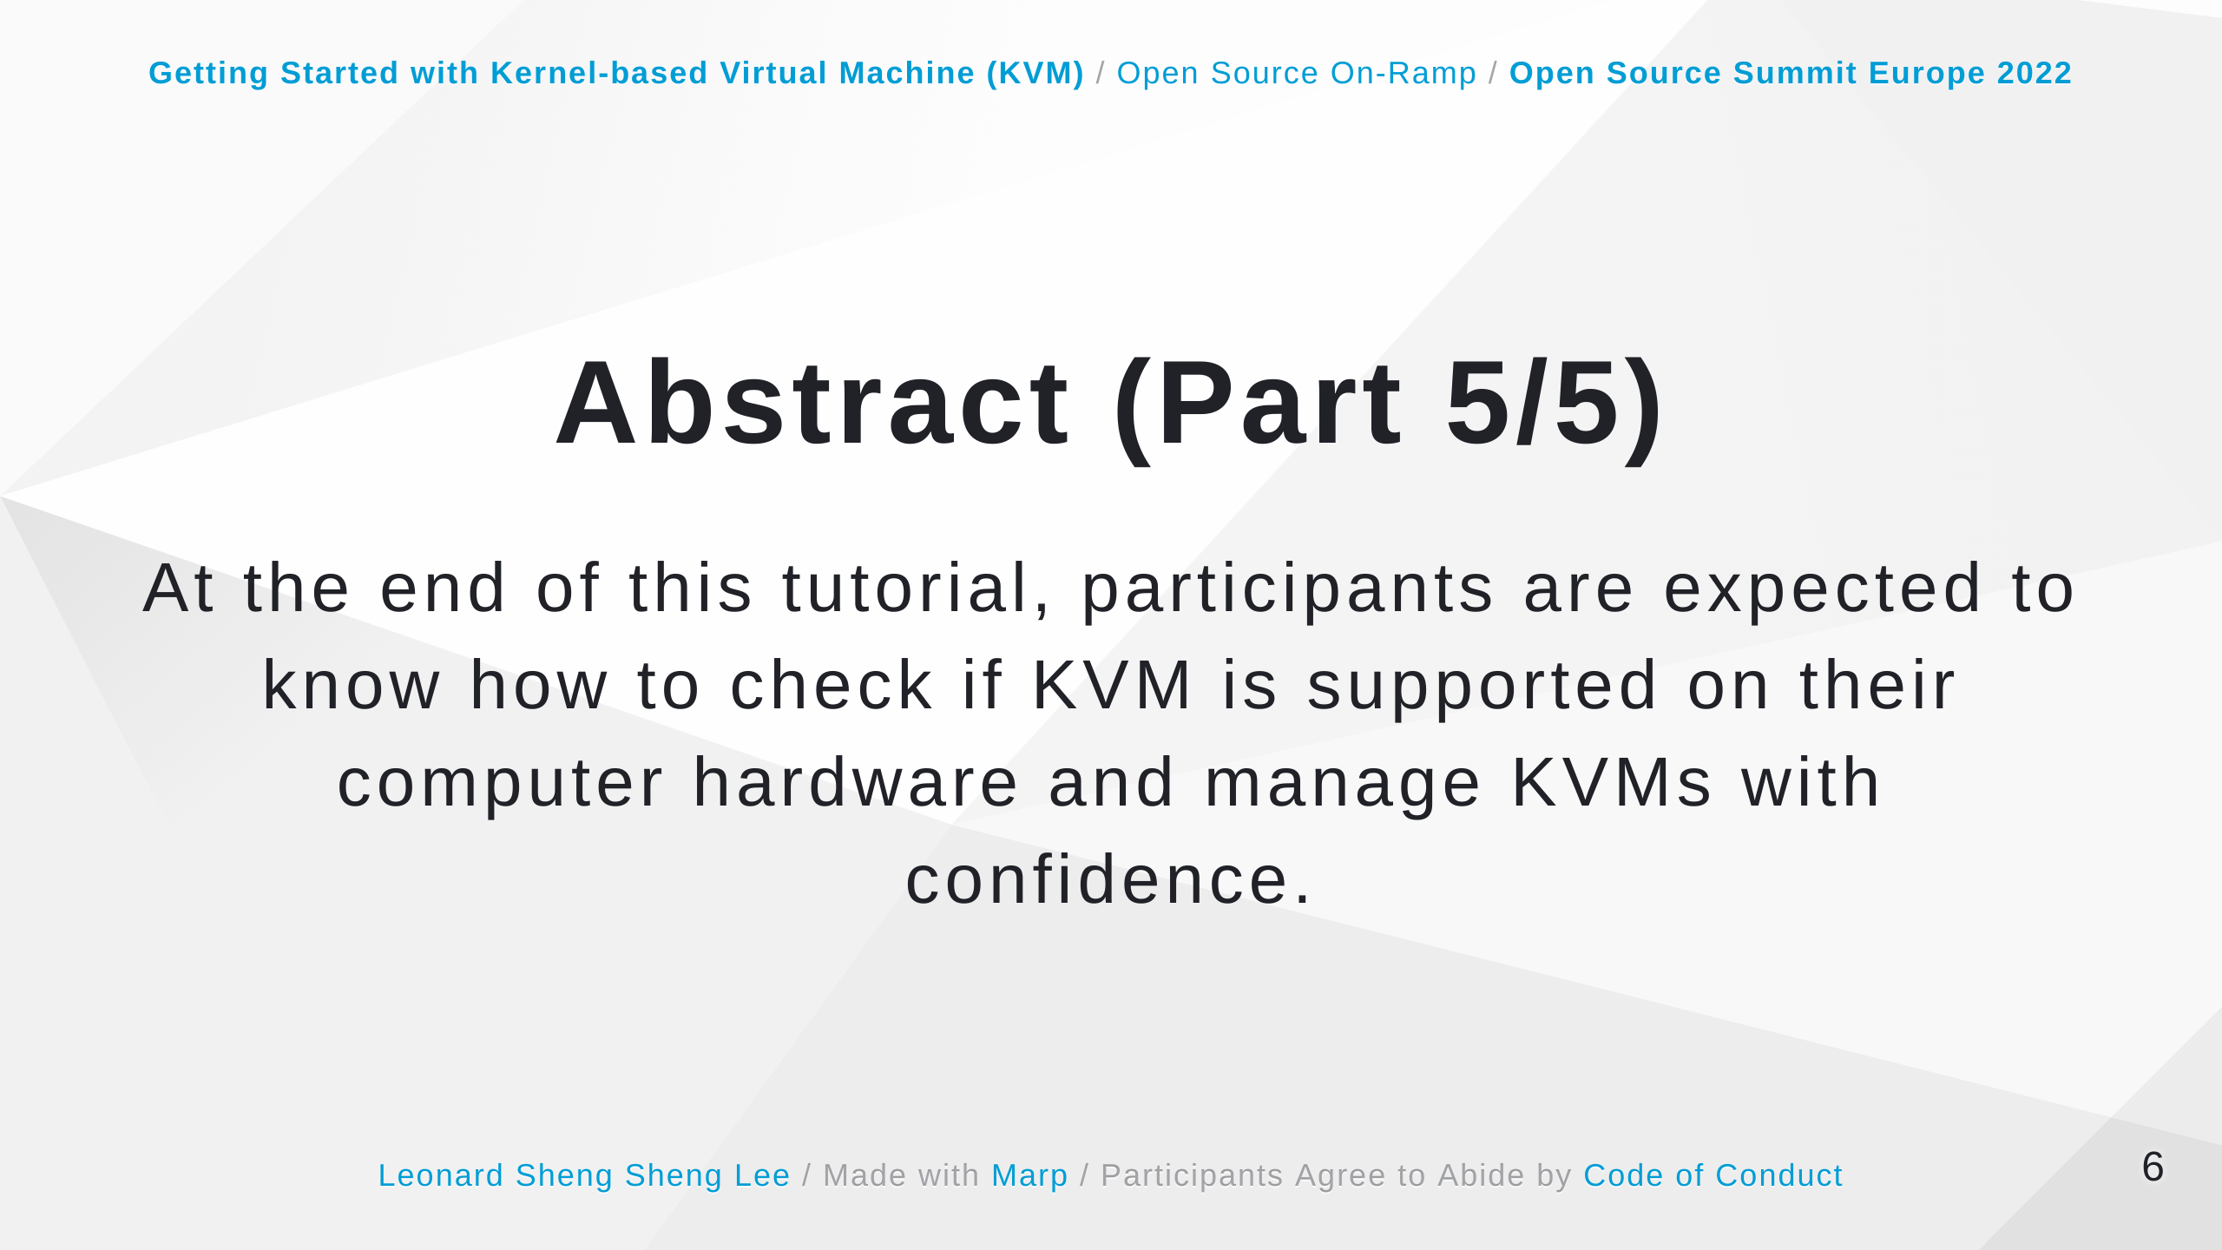

Slide 7
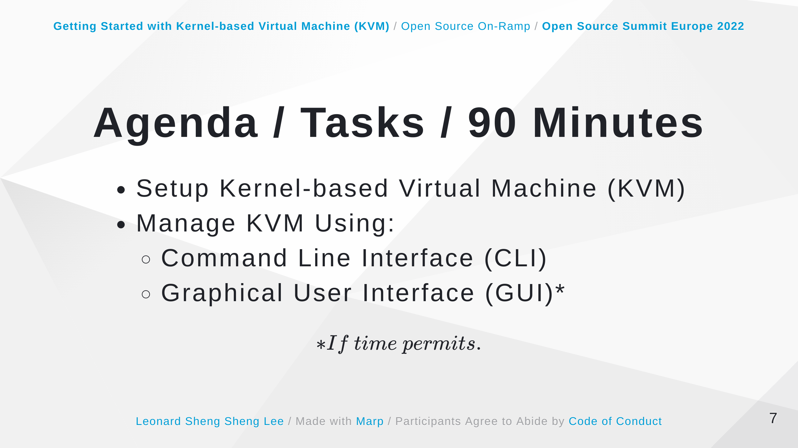

Slide 8


Slide 9
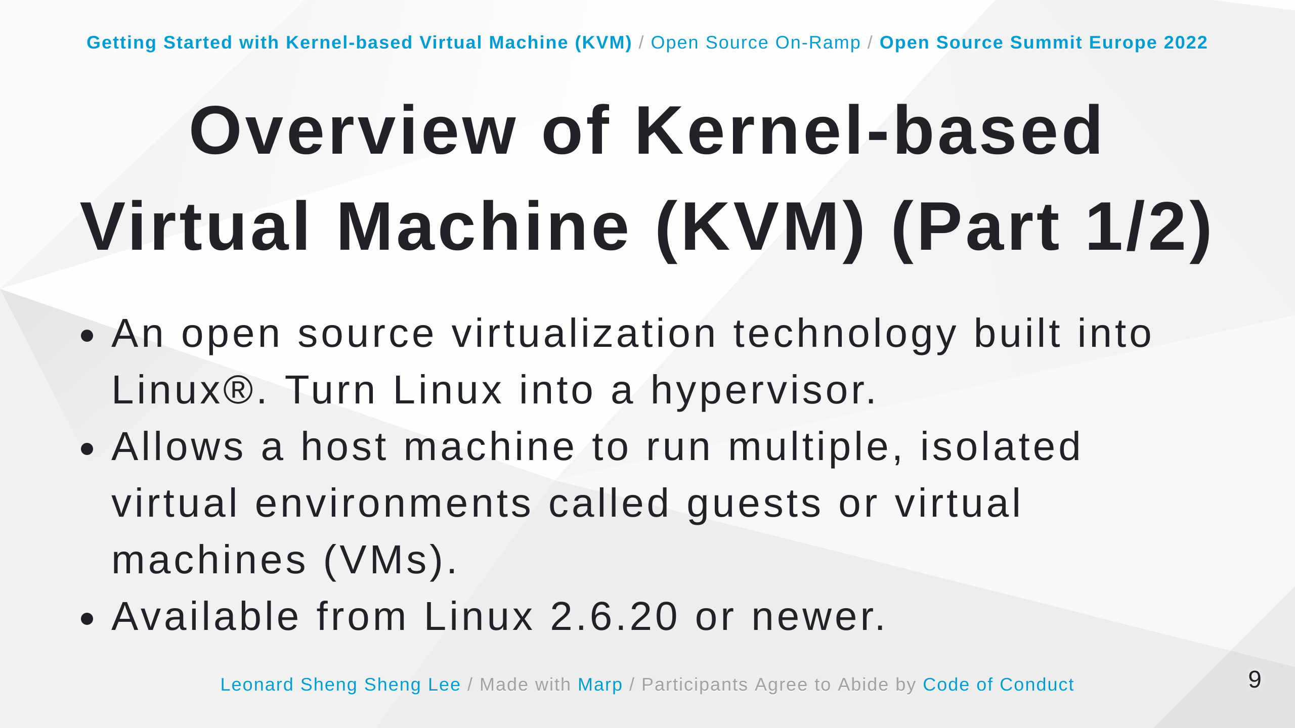
Notes:
Some speaker notes here that might be useful. The default virtualization technology supported in Ubuntu is KVM. For Intel and AMD hardware KVM requires virtualization extensions. But KVM is also available for IBM Z and LinuxONE, IBM POWER as well as for ARM64.

Slide 10
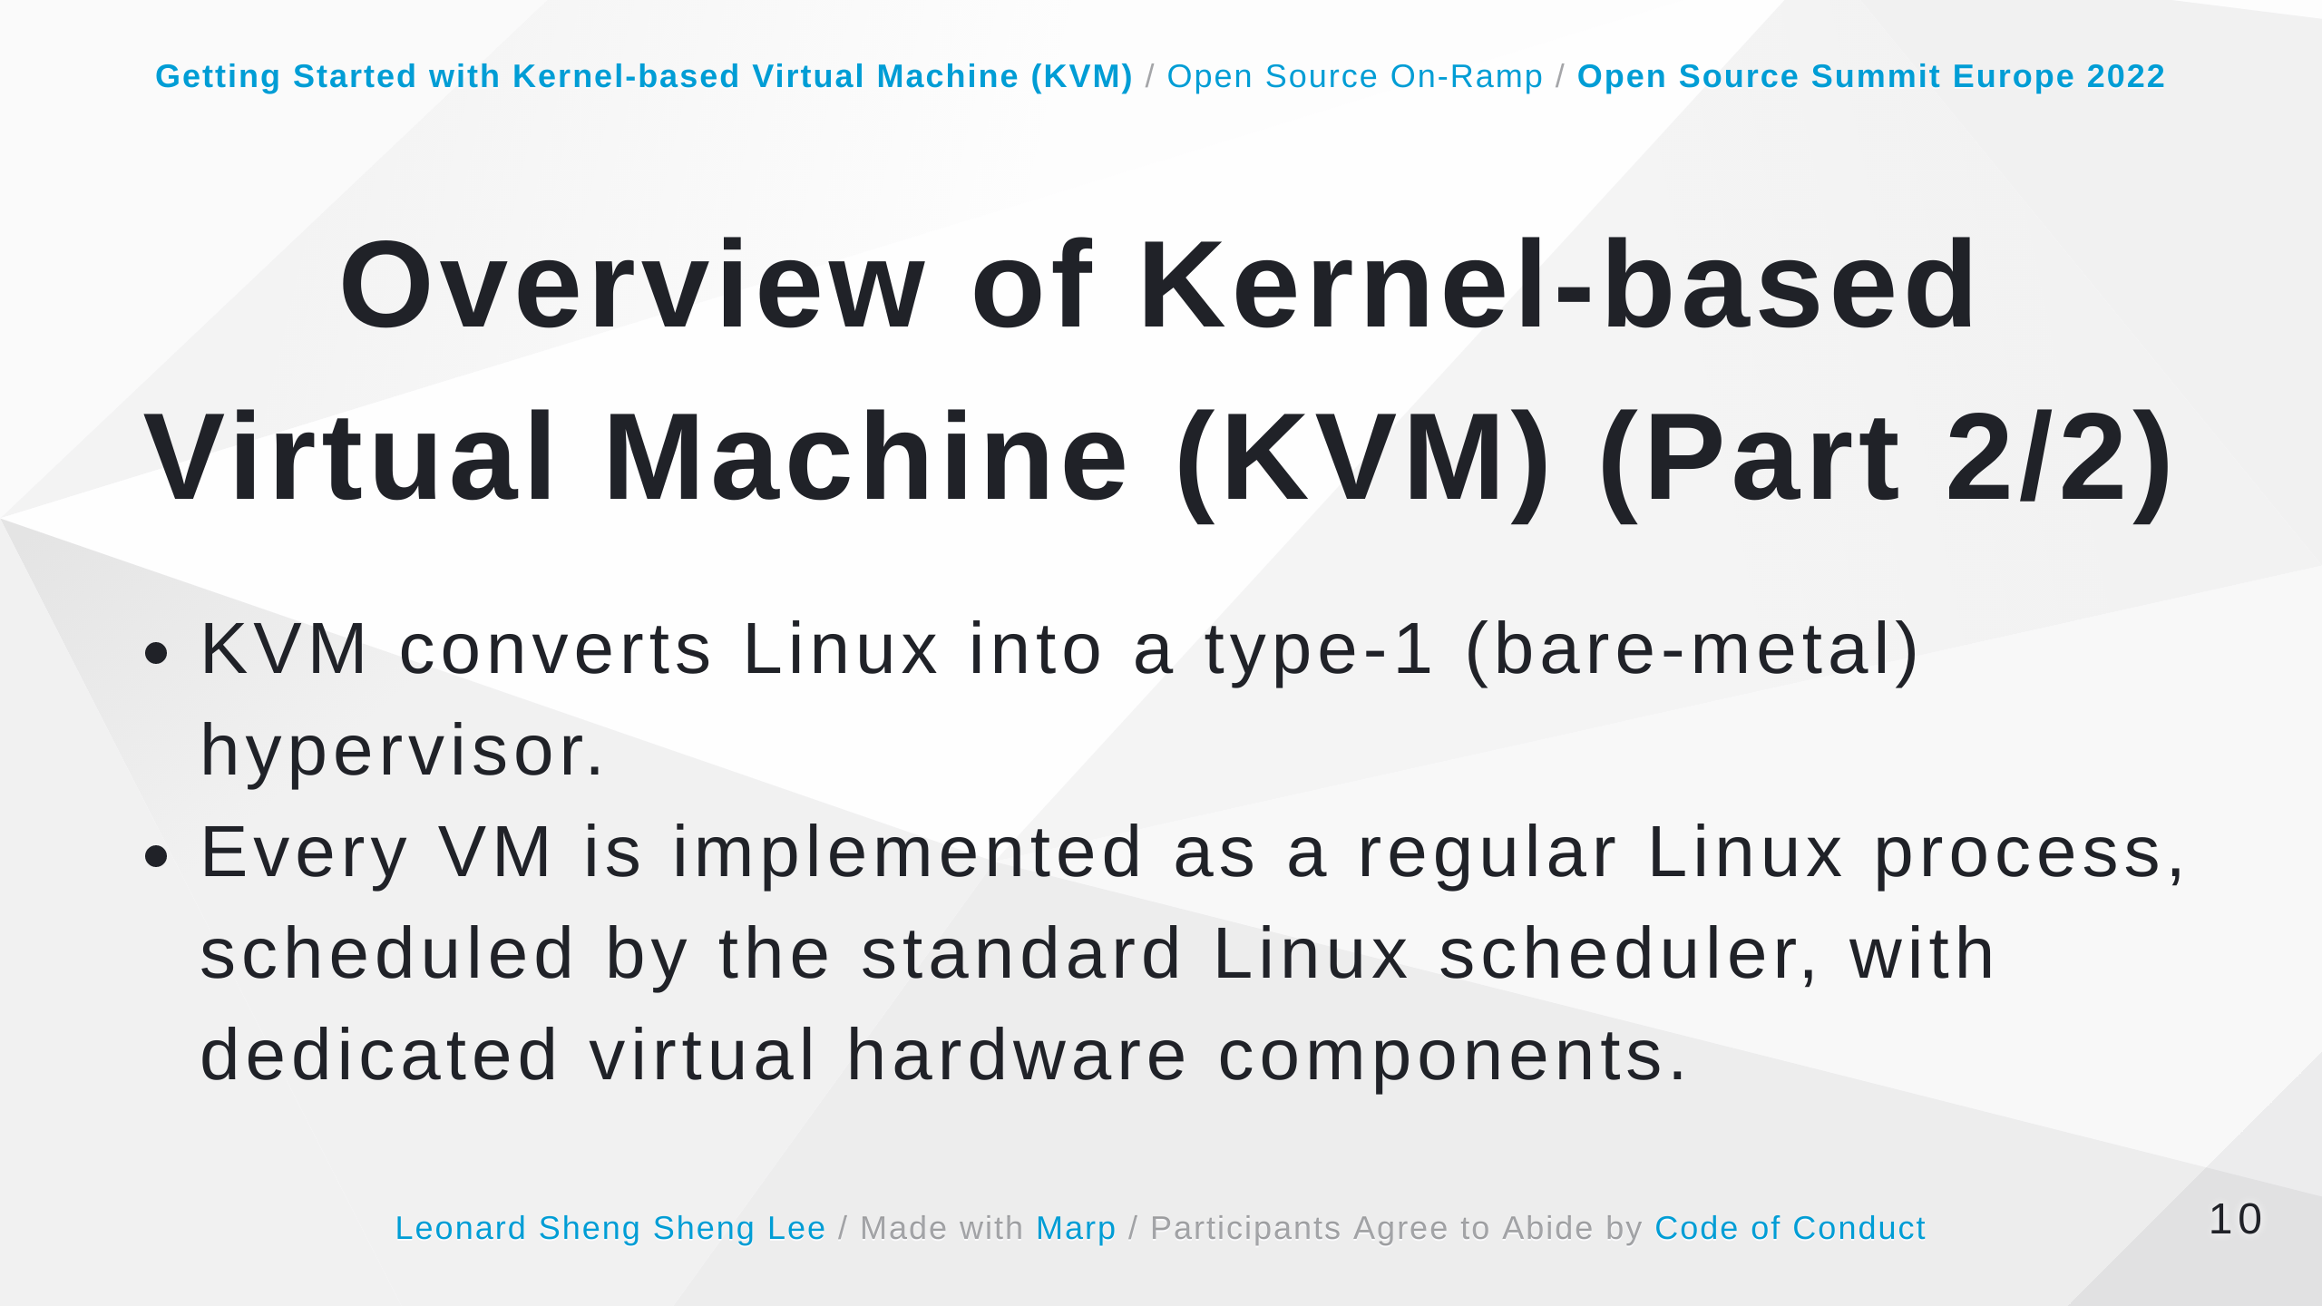
Notes:
Some speaker notes here that might be useful. +KVM converts Linux into a type-1 (bare-metal) hypervisor. All hypervisors need some operating system-level components—such as a memory manager, process scheduler, input/output (I/O) stack, device drivers, security manager, a network stack, and more—to run VMs. KVM has all these components because it’s part of the Linux kernel. Every VM is implemented as a regular Linux process, scheduled by the standard Linux scheduler, with dedicated virtual hardware like a network card, graphics dapter, CPU(s), memory, and disks. https://www.redhat.com/en/topics/virtualization/what-is-KVM

Slide 11
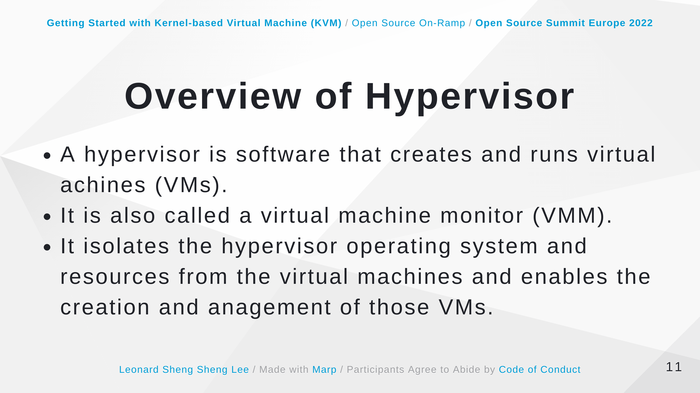
Notes:
Some speaker notes here that might be useful. https://www.redhat.com/en/topics/virtualization/hat-is-a-hypervisor

Slide 12
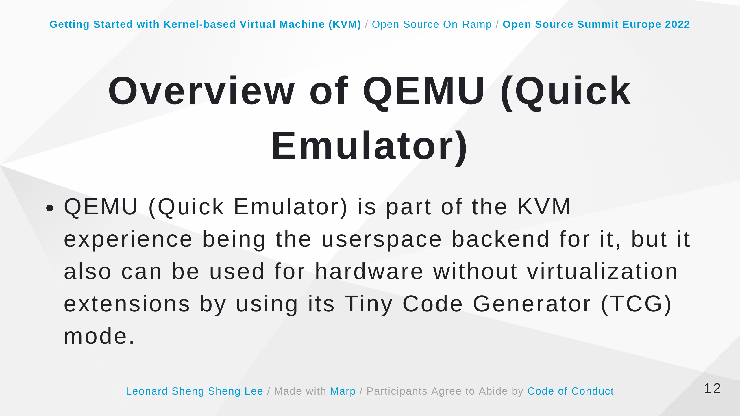
Notes:
Some speaker notes here that might be useful. The Tiny Code Generator (TCG) is the core binary translation engine that is responsible for QEMU ability to emulate foreign processors on any given supported host.

Slide 13
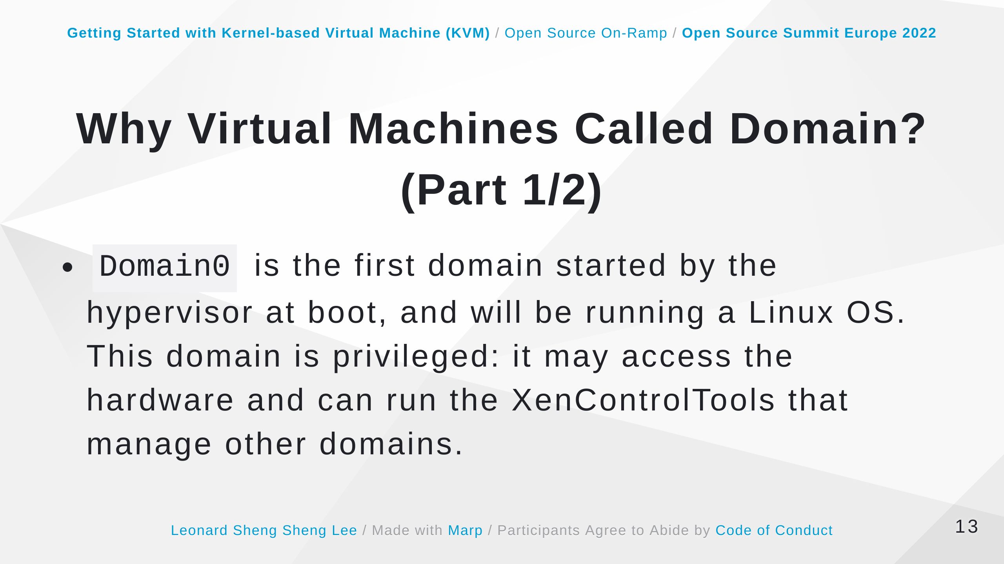
Notes:
Some speaker notes here that might be useful. https://wiki.xenproject.org/wiki/Domain https://wiki.xenproject.org/wiki/Dom0

Slide 14
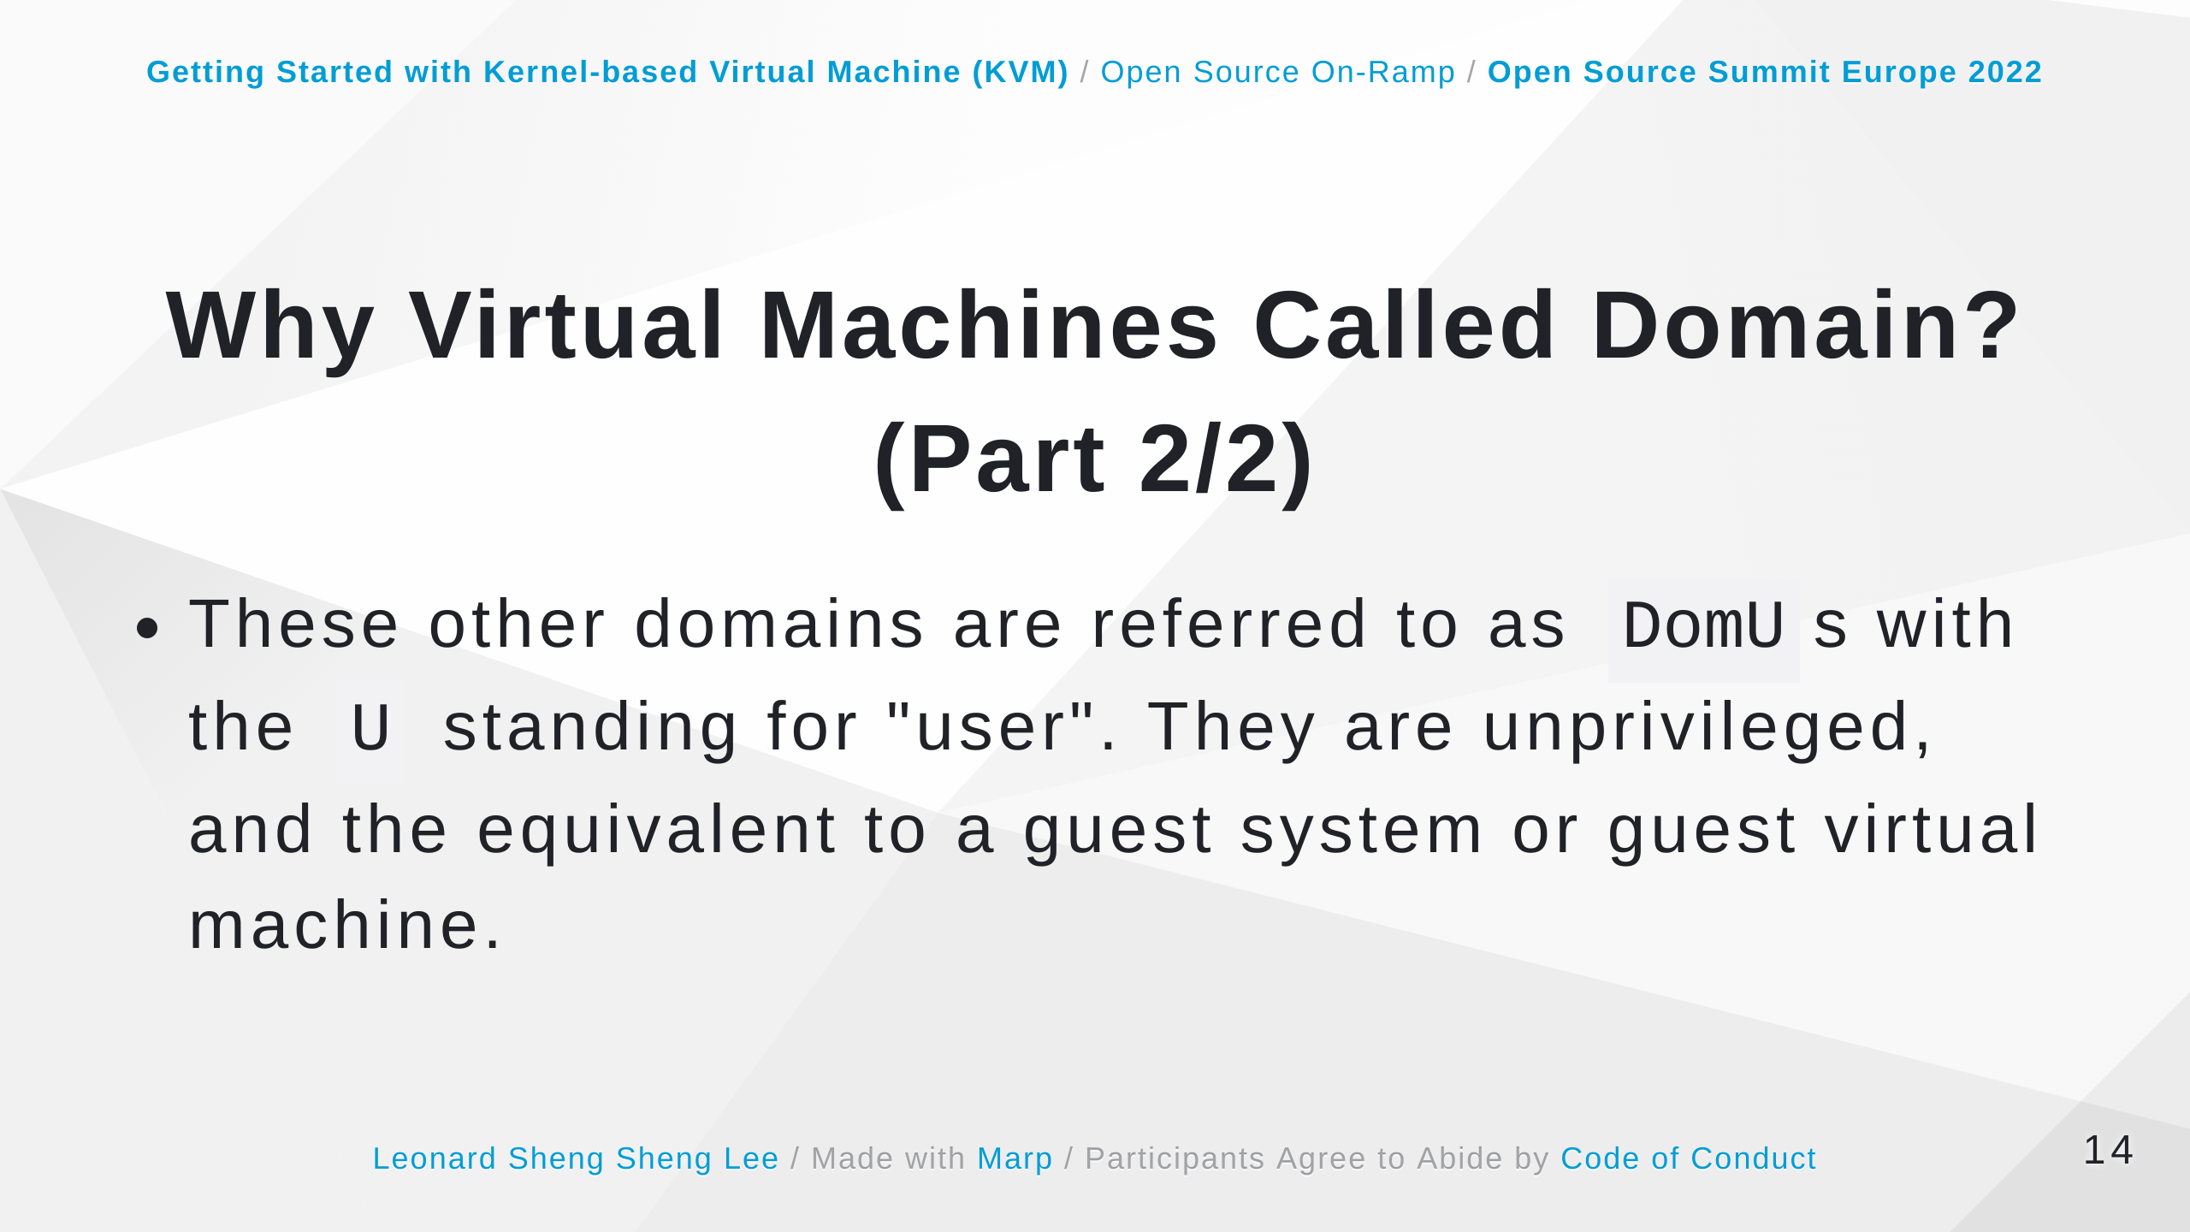
Notes:
Some speaker notes here that might be useful. https://wiki.xenproject.org/wiki/Domain https://wiki.xenproject.org/wiki/DomU

Slide 15
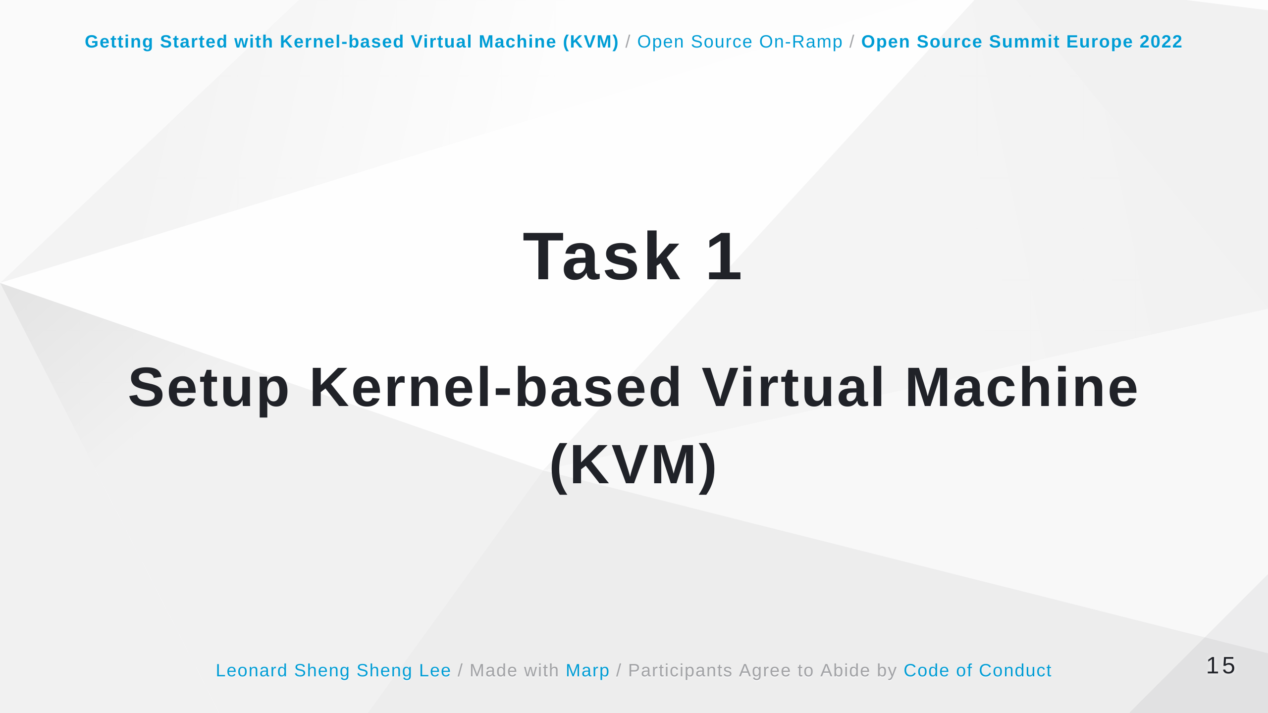

Slide 16
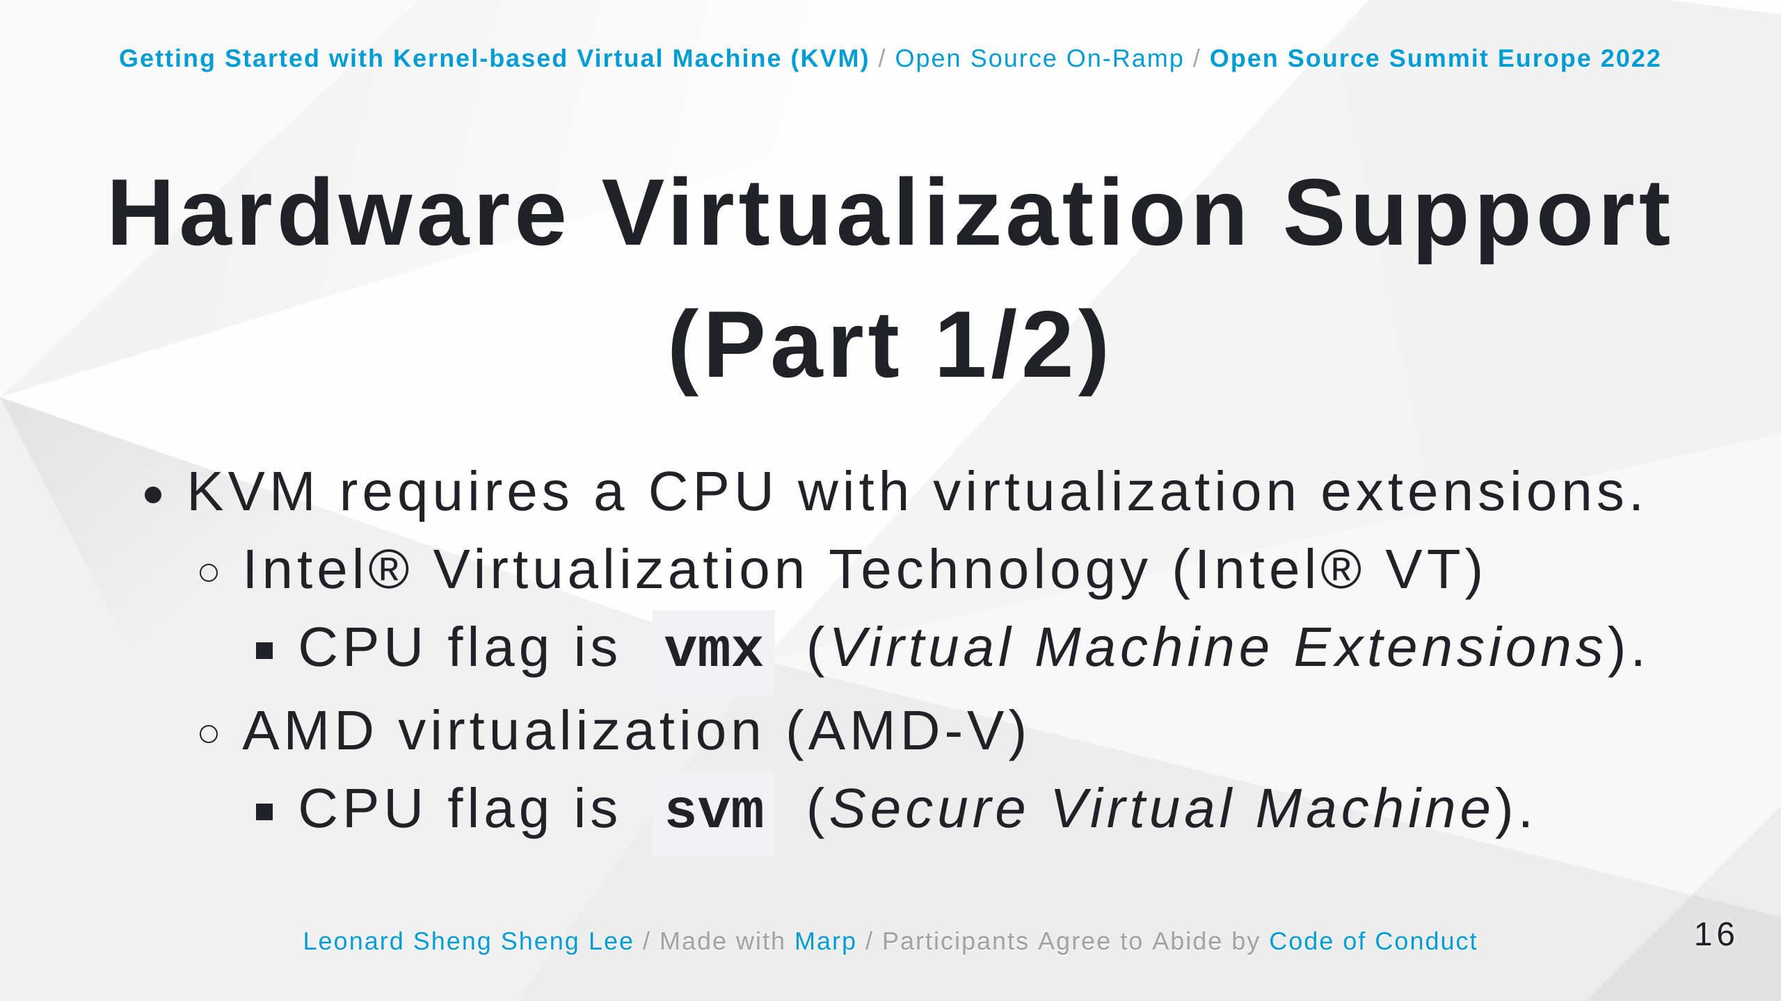

Slide 17
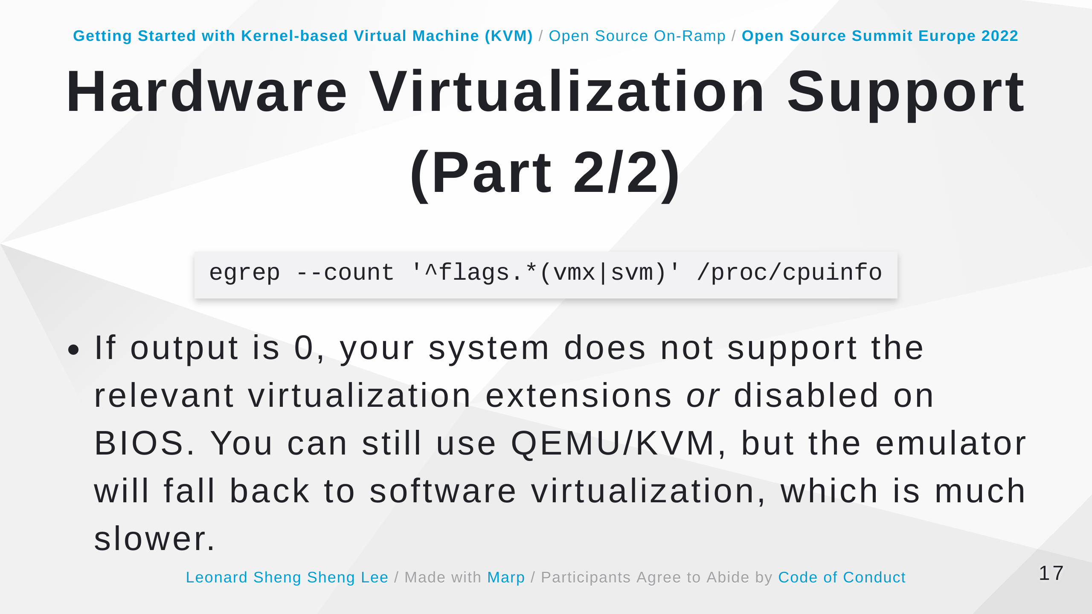

Slide 18
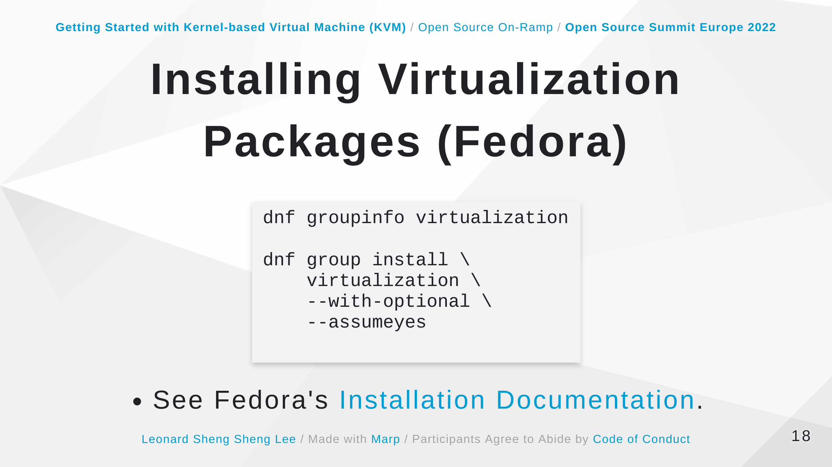

Slide 19
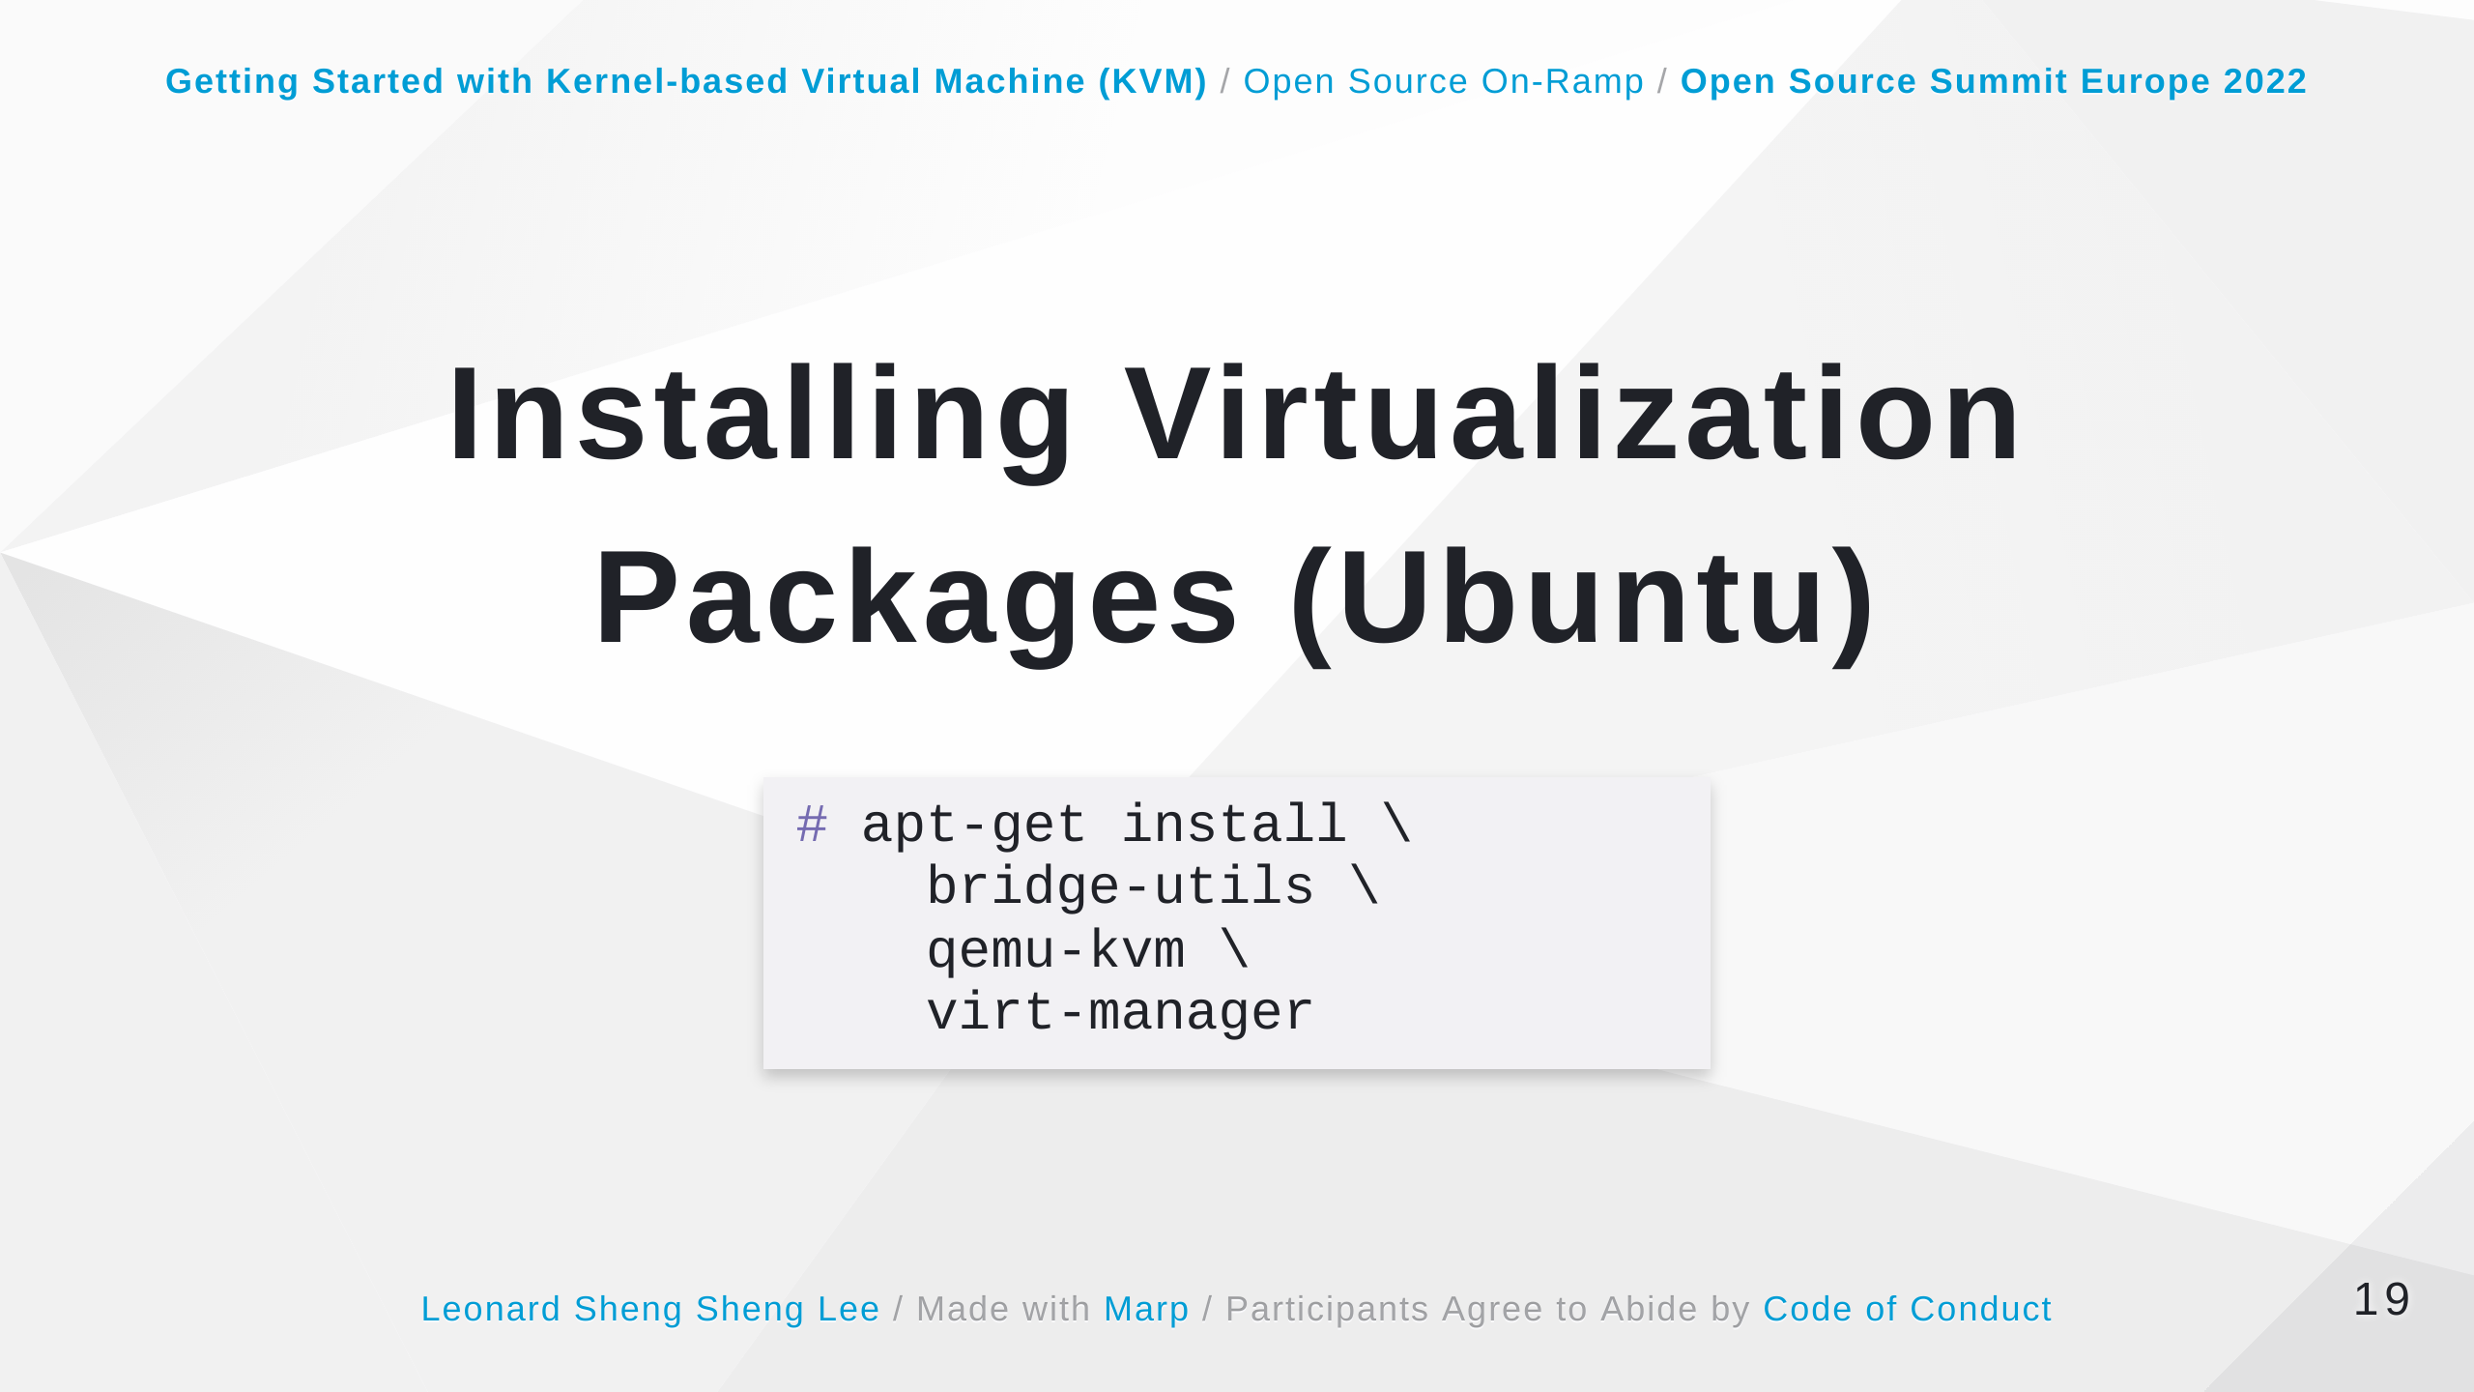

Slide 20
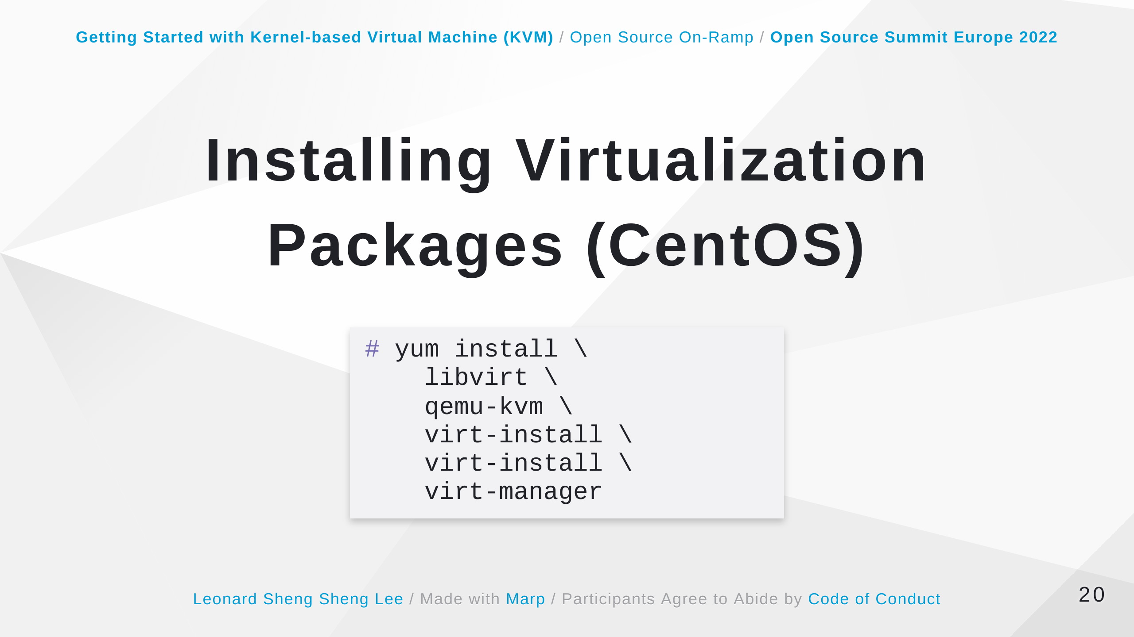

Slide 21
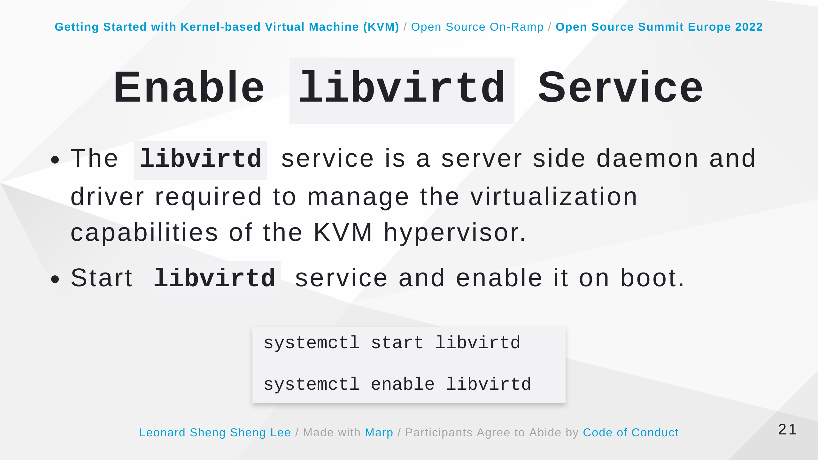

Slide 22
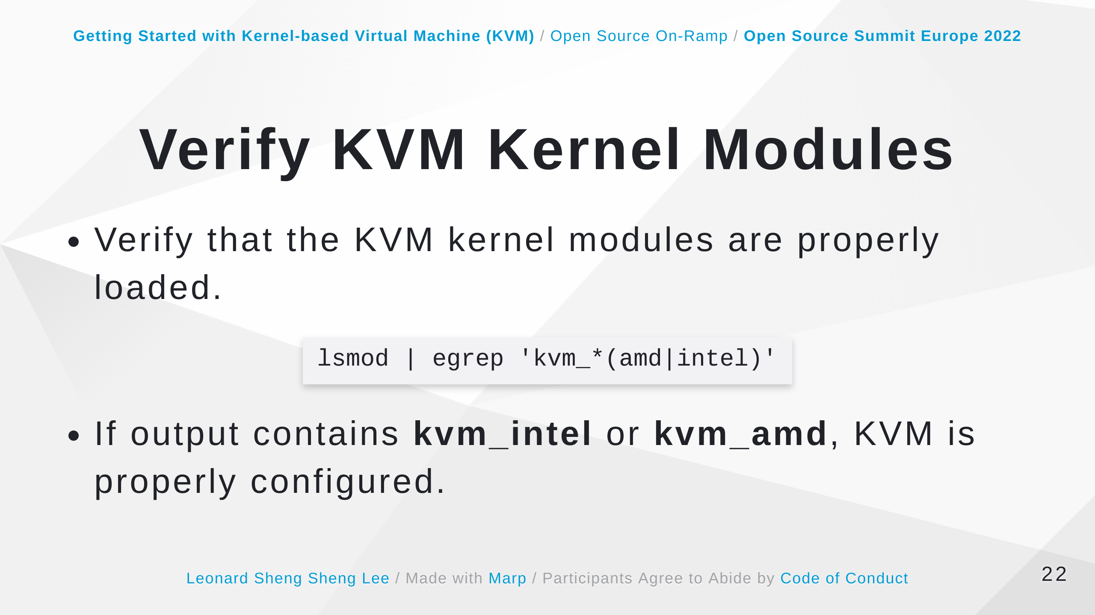

Slide 23
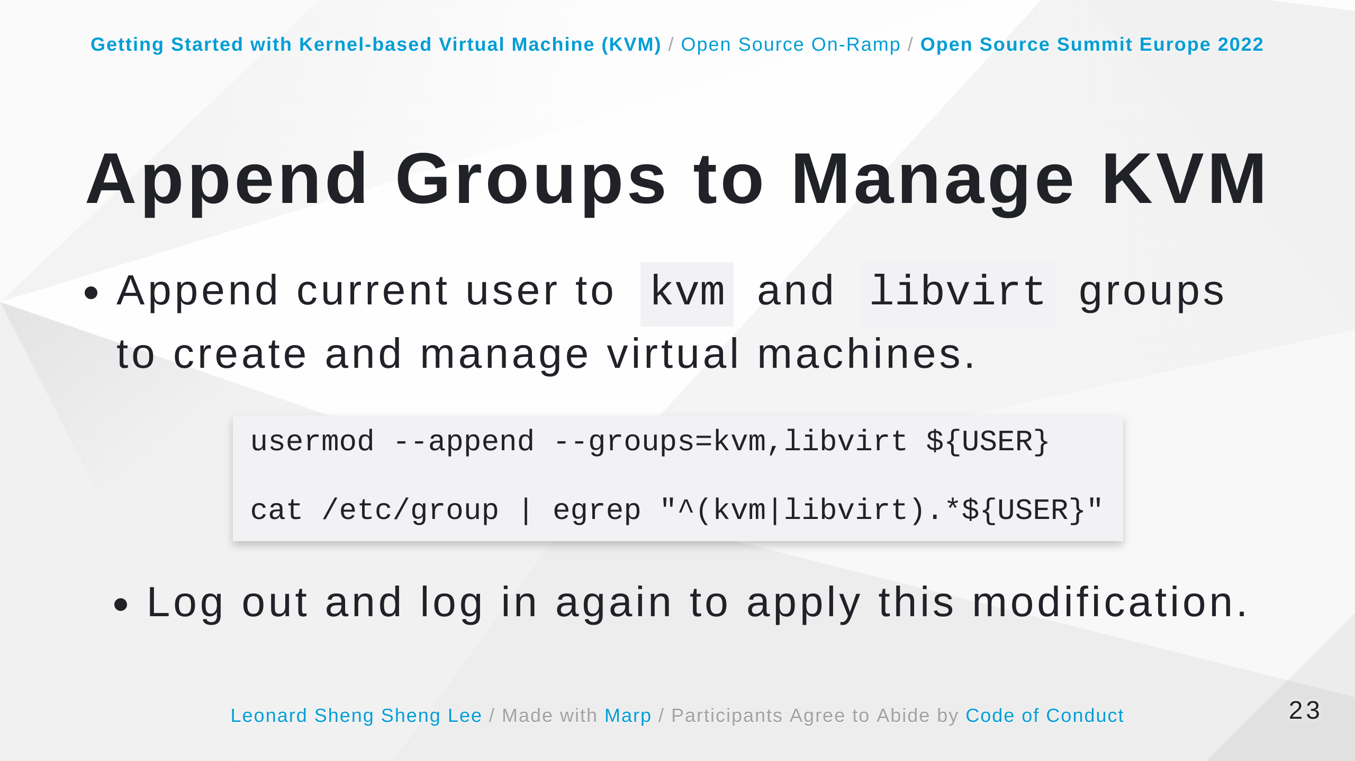
Notes:
Some speaker notes here that might be useful. Note that this if this command only displays guest virtual machines created by the root user. If it does not display a virtual machine you know you have created, it is probable you did not create the virtual machine as root. Guests created using the virt-manager interface are by default created by root. https://access.redhat.com/documentation/en-us/red_hat_enterprise_linux/7/html/virtualization_deployment_and_administration_guide/sect-domain_commands-editing_and_displaying_a_description_and_title_of_a_domain#doc-wrapper

Slide 24
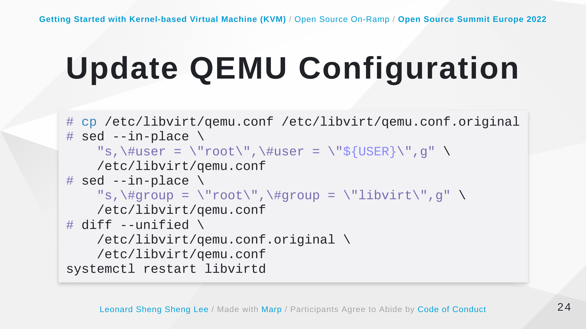

Slide 25
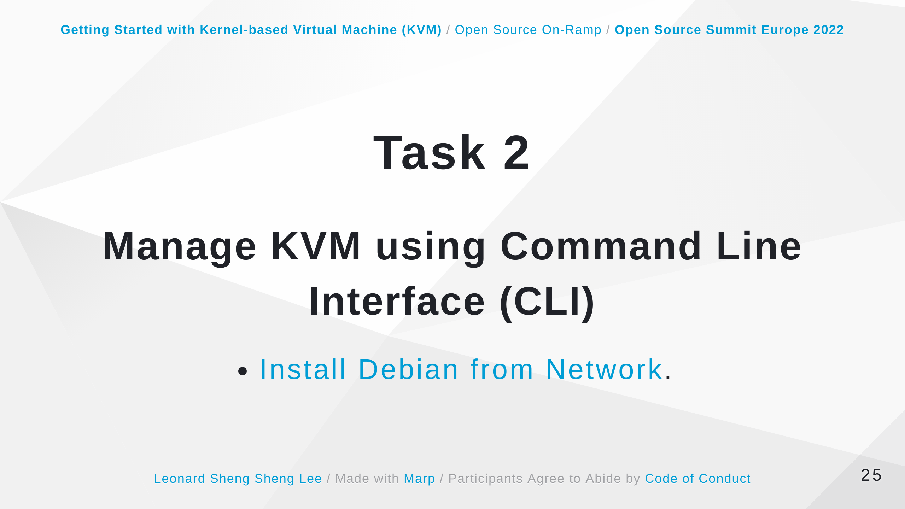

Slide 26
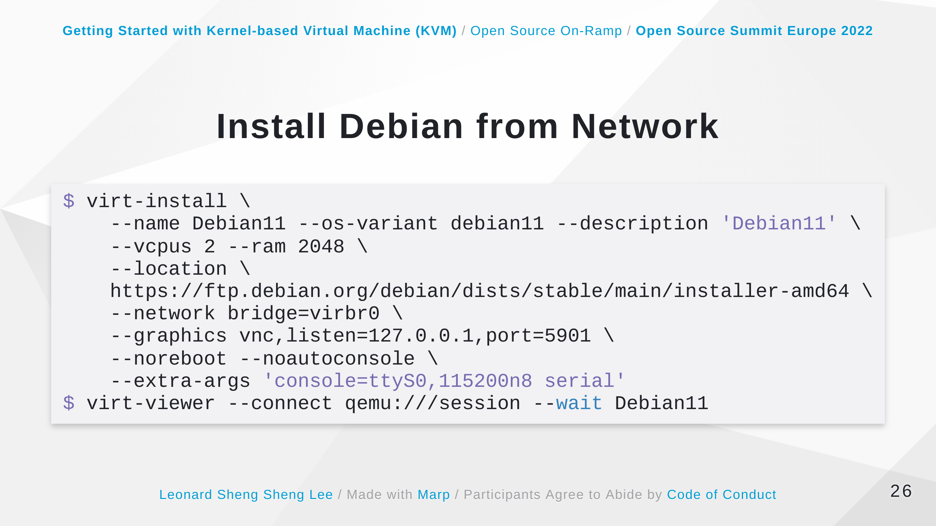
Notes:
Some speaker notes here that might be useful. Opens an interactive console that you can use to manually install the guest virtual machine. An example kernel command line option to specify the serial console (and it's settings) are: console=ttyS0,115200n8 This option tells the kernel to use ttyS0 (the first serial port), with settings of speed=115200 cps, no stop bits and 8 data bits. The serial ports of the host and the target should be configured to match in terms of the speed, stop bits and data bits. Minicom is a common serial communications program used on host machines for accessing the console from the host.

Slide 27
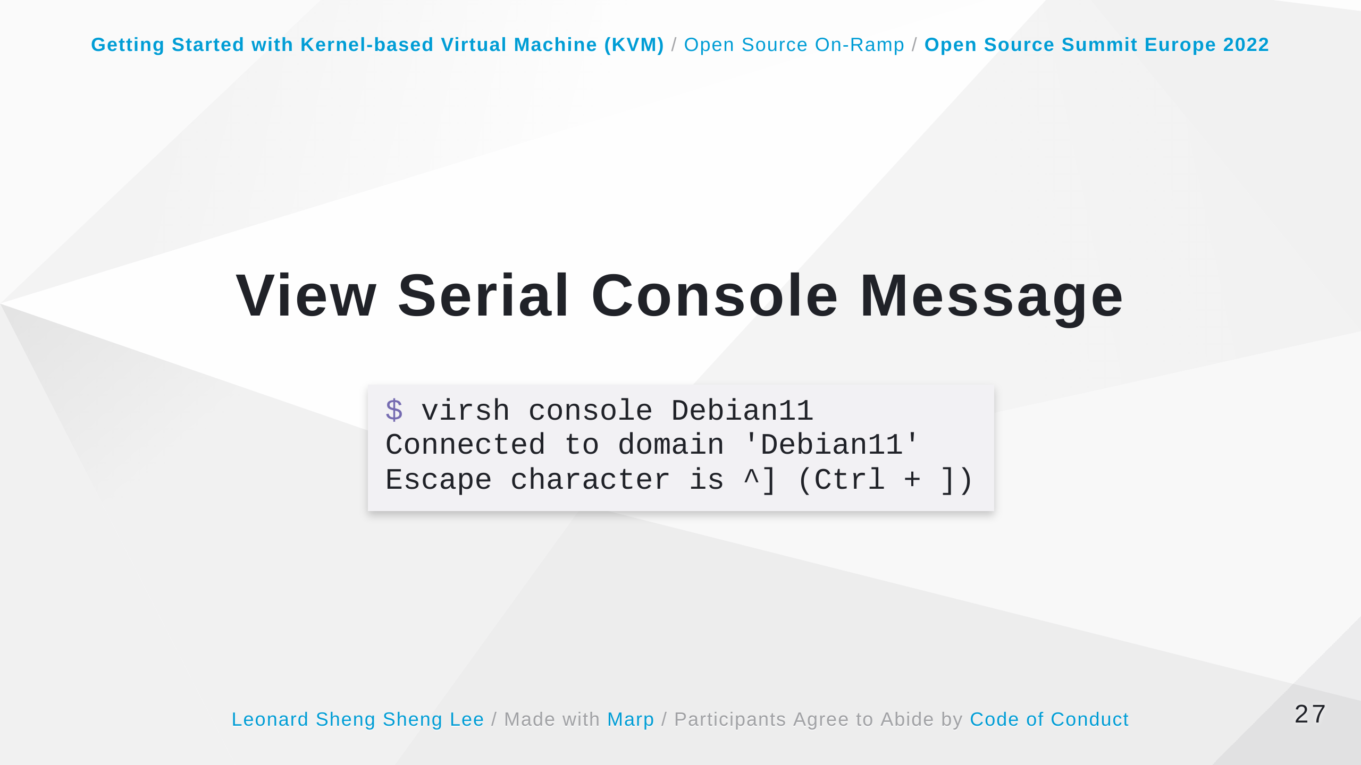

Slide 28
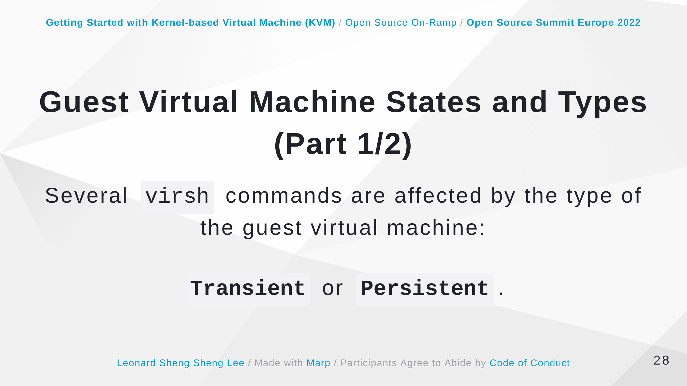
Notes:
Some speaker notes here that might be useful. - Transient (A transient guest does not survive reboot.) - Persistent (A persistent guest virtual machine survives reboot and lasts until it is deleted.) https://access.redhat.com/documentation/en-us/red_hat_enterprise_linux/7/html/virtualization_deployment_and_administration_guide/chap-managing_guest_virtual_machines_with_virsh#domain-states

Slide 29
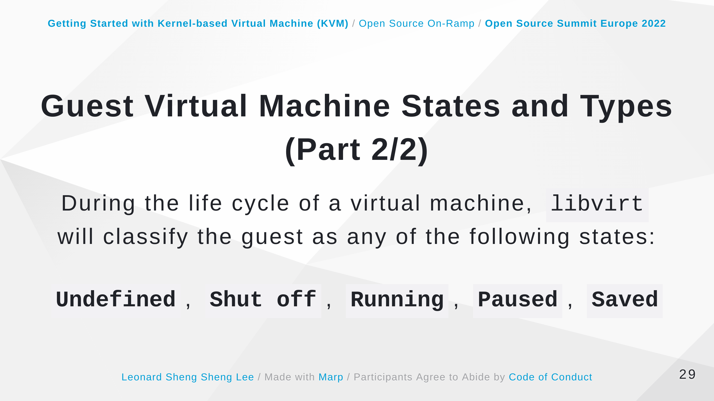
Notes:
Some speaker notes here that might be useful. During the life cycle of a virtual machine, libvirt will classify the guest as any of the following states: Undefined - This is a guest virtual machine that has not been defined or created. As such, libvirt is unaware of any guest in this state and will not report about guest virtual machines in this state. Shut off - This is a guest virtual machine which is defined, but is not running. Only persistent guests can be considered shut off. As such, when a transient guest virtual machine is put into this state, it ceases to exist. Running - The guest virtual machine in this state has been defined and is currently working. This state can be used with both persistent and transient guest virtual machines. Paused - The guest virtual machine's execution on the hypervisor has been suspended, or its state has been temporarily stored until it is resumed. Guest virtual machines in this state are not aware they have been suspended and do not notice that time has passed when they are resumed. Saved - This state is similar to the paused state, however the guest virtual machine's configuration is saved to persistent storage. Any guest virtual machine in this state is not aware it is paused and does not notice that time has passed once it has been restored. https://access.redhat.com/documentation/en-us/red_hat_enterprise_linux/7/html/virtualization_deployment_and_administration_guide/chap-managing_guest_virtual_machines_with_virsh#domain-states

Slide 30
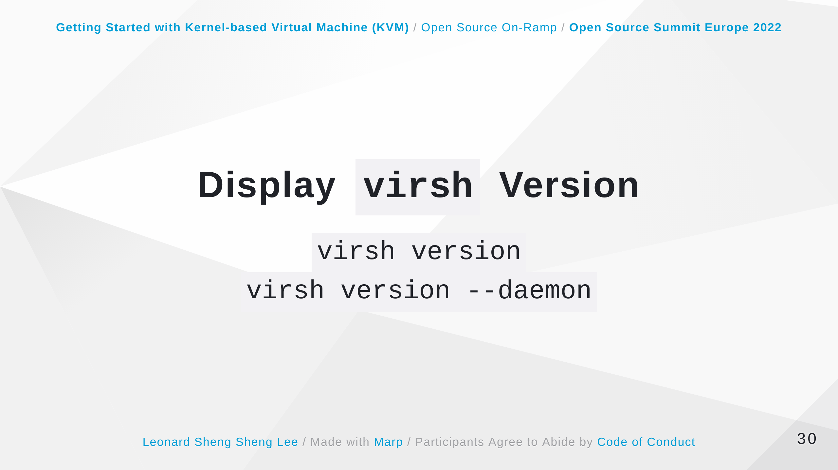
Notes:
Some speaker notes here that might be useful. The virsh version command displays the current libvirt version and displays information about the local virsh client. The virsh version --daemon is useful for getting information about the libvirtd version and package information, including information about the libvirt daemon that is running on the host. https://access.redhat.com/documentation/en-us/red_hat_enterprise_linux/7/html/virtualization_deployment_and_administration_guide/sect-generic_commands-version#doc-wrapper

Slide 31
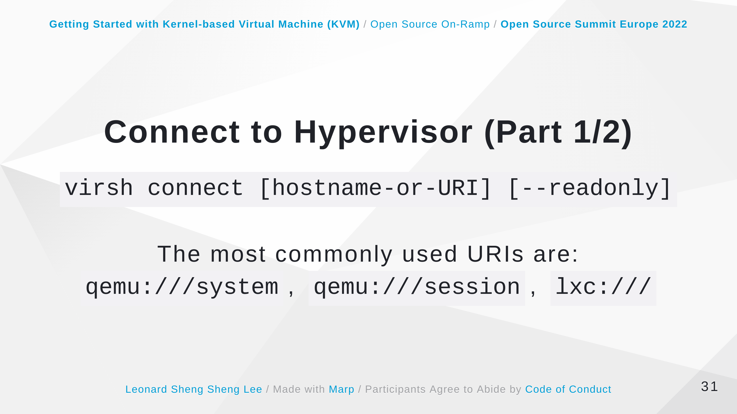
Notes:
Some speaker notes here that might be useful. The most commonly used URIs are: qemu:///system - connects locally as the root user to the daemon supervising guest virtual machines on the KVM hypervisor. qemu:///session - connects locally as a user to the user's set of guest local machines using the KVM hypervisor. lxc:/// - connects to a local Linux container. https://access.redhat.com/documentation/en-us/red_hat_enterprise_linux/7/html/virtualization_deployment_and_administration_guide/sect-generic_commands-connect#doc-wrapper

Slide 32
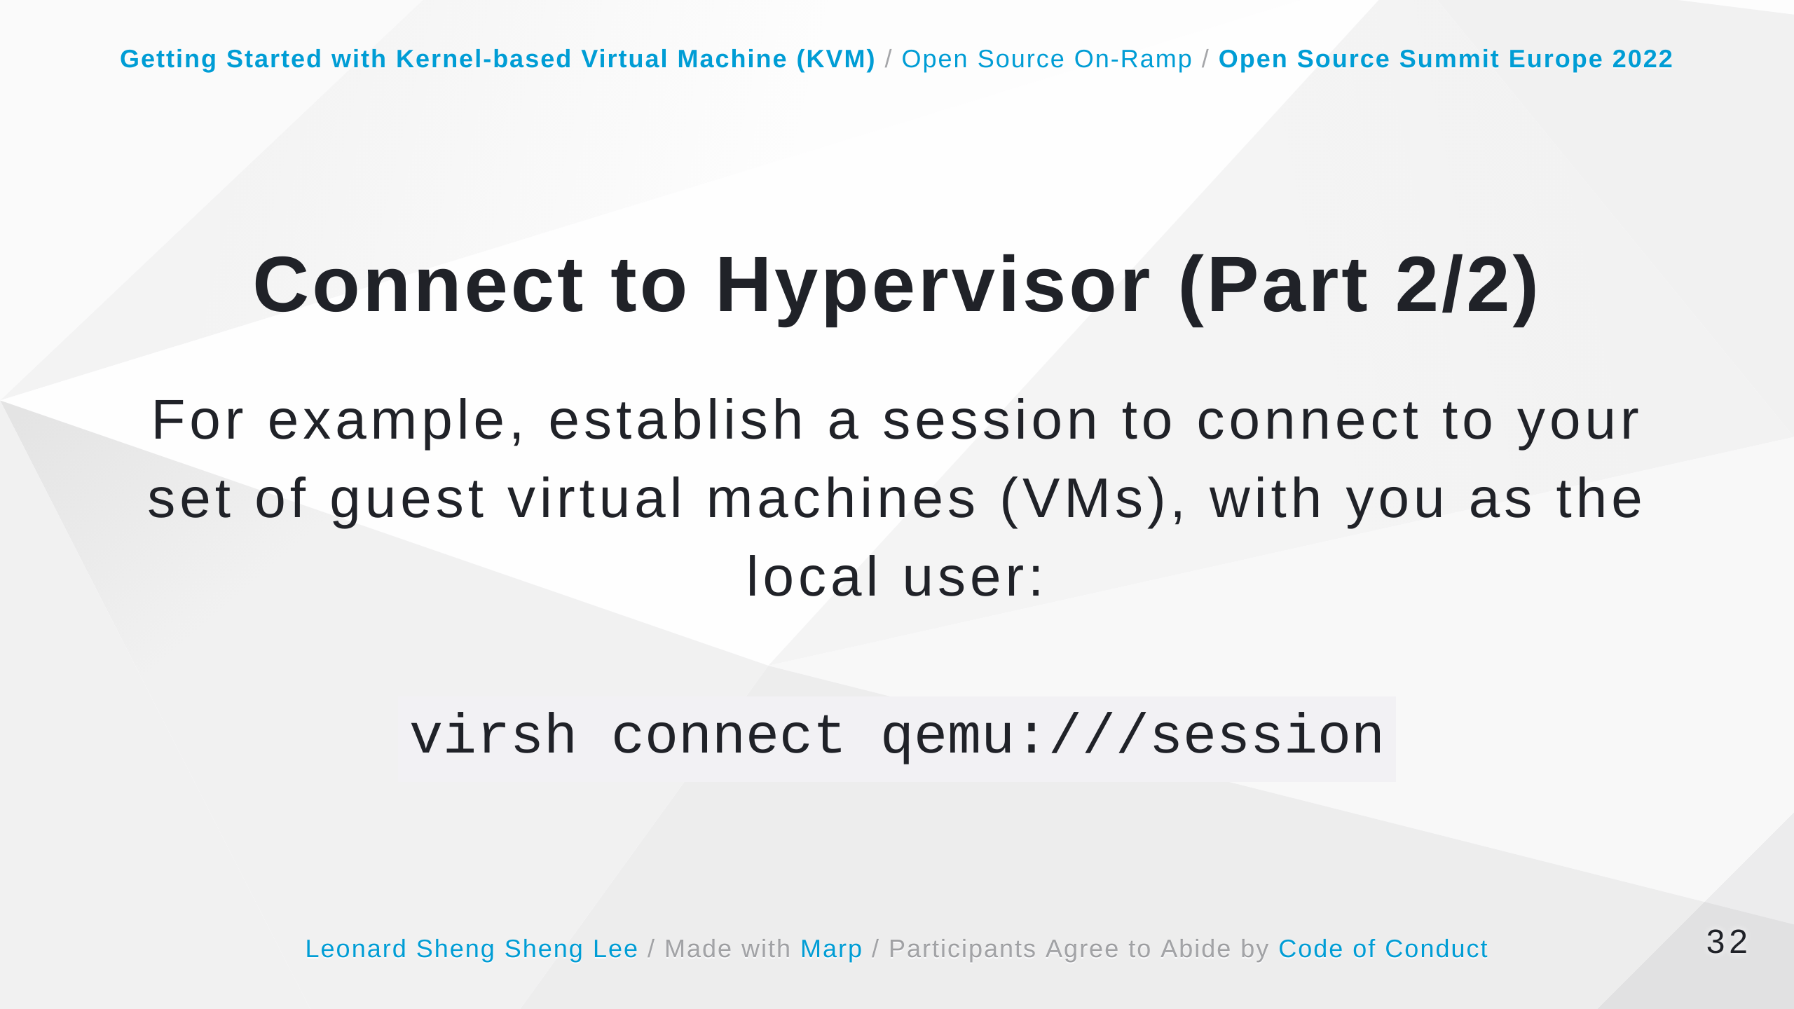
Notes:
Some speaker notes here that might be useful. https://access.redhat.com/documentation/en-us/red_hat_enterprise_linux/7/html/virtualization_deployment_and_administration_guide/sect-generic_commands-connect#doc-wrapper

Slide 33
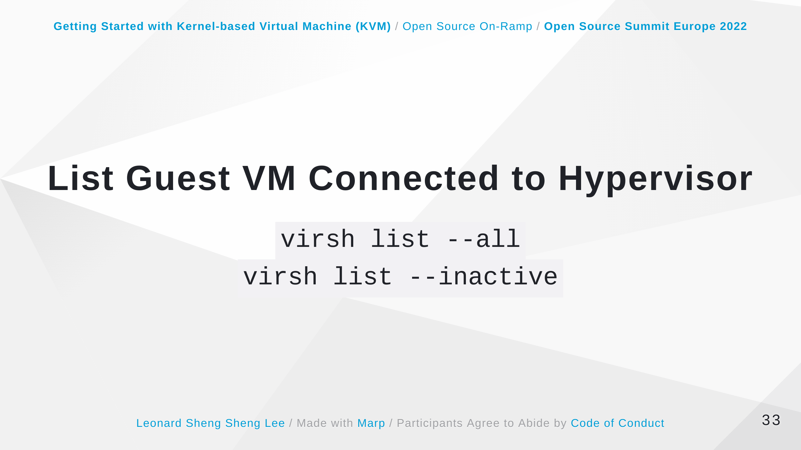
Notes:
Some speaker notes here that might be useful. Each guest virtual machine is listed with its ID, name, and state. Note that this if this command only displays guest virtual machines created by the root user. If it does not display a virtual machine you know you have created, it is probable you did not create the virtual machine as root. Guests created using the virt-manager interface are by default created by root. https://access.redhat.com/documentation/en-us/red_hat_enterprise_linux/7/html/virtualization_deployment_and_administration_guide/sect-domain_commands-editing_and_displaying_a_description_and_title_of_a_domain#doc-wrapper

Slide 34
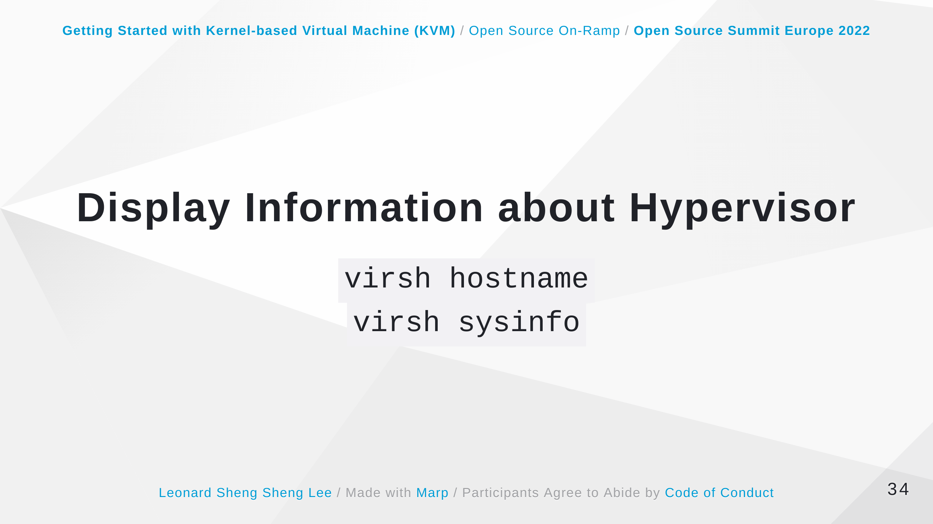
Notes:
Some speaker notes here that might be useful. https://access.redhat.com/documentation/en-us/red_hat_enterprise_linux/7/html/virtualization_deployment_and_administration_guide/sect-domain_commands-editing_and_displaying_a_description_and_title_of_a_domain#doc-wrapper

Slide 35
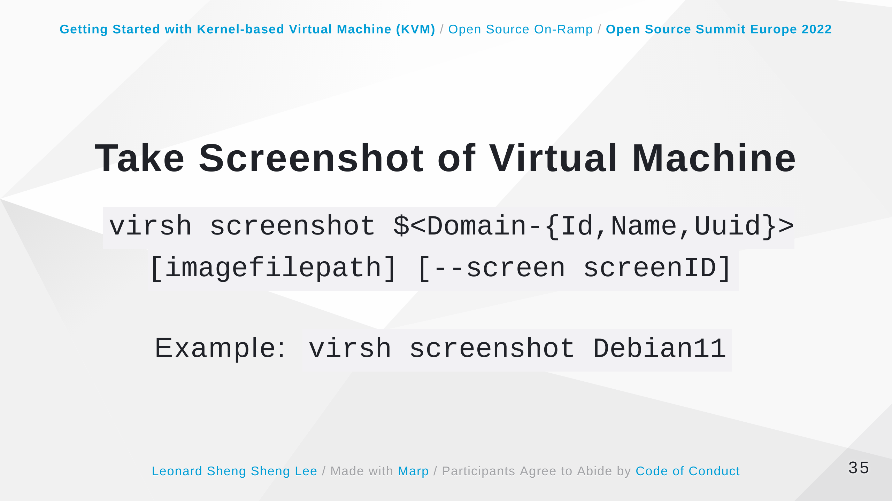
Notes:
Takes a screenshot of a current domain console and stores it into a file. Optionally, if hypervisor supports more displays for a domain, screenID allows to specify which screen will be captured. It is the sequential number of screen. In case of multiple graphics cards, heads are enumerated before devices, e.g. having two graphics cards, both with four heads, screen ID 5 addresses the second head on the second card. https://linux.die.net/man/1/virsh

Slide 36
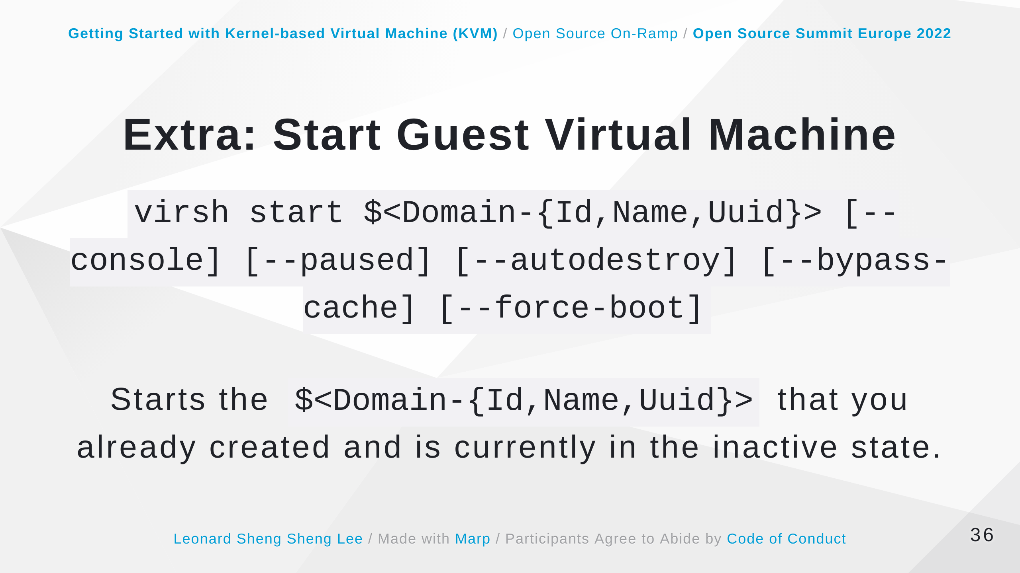
Notes:
Some speaker notes here that might be useful. Starts an inactive virtual machine that was already defined but whose state is inactive since its last managed save state or a fresh boot. By default, if the domain was saved by the virsh managedsave command, the domain will be restored to its previous state. Otherwise, it will be freshly booted. The command can take the following arguments and the name of the virtual machine is required. --console - will attach the terminal running virsh to the domain's console device. This is runlevel 3. --paused - if this is supported by the driver, it will start the guest virtual machine in a paused state --autodestroy - the guest virtual machine is automatically destroyed when virsh disconnects --bypass-cache - used if the guest virtual machine is in the managedsave --force-boot - discards any managedsave options and causes a fresh boot to occur https://access.redhat.com/documentation/en-us/red_hat_enterprise_linux/7/html/virtualization_deployment_and_administration_guide/sect-starting_suspending_resuming_saving_and_restoring_a_guest_virtual_machine-starting_a_defined_domain#sect-start-vm

Slide 37
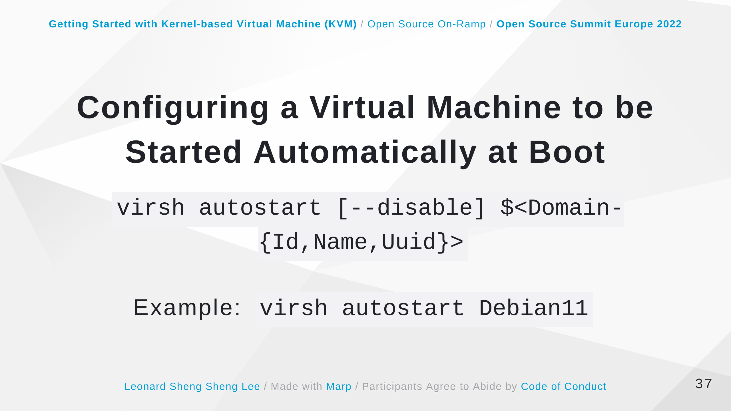
Notes:
Some speaker notes here that might be useful. The command will automatically start the guest virtual machine when the host machine boots. Adding the --disable argument to this command disables autostart. The guest in this case will not start automatically when the host physical machine boots. https://access.redhat.com/documentation/en-us/red_hat_enterprise_linux/7/html/virtualization_deployment_and_administration_guide/sect-starting_suspending_resuming_saving_and_restoring_a_guest_virtual_machine-starting_a_defined_domain#sect-Domain_Commands-Configuring_a_domain_to_be_started_automatically_at_boot

Slide 38
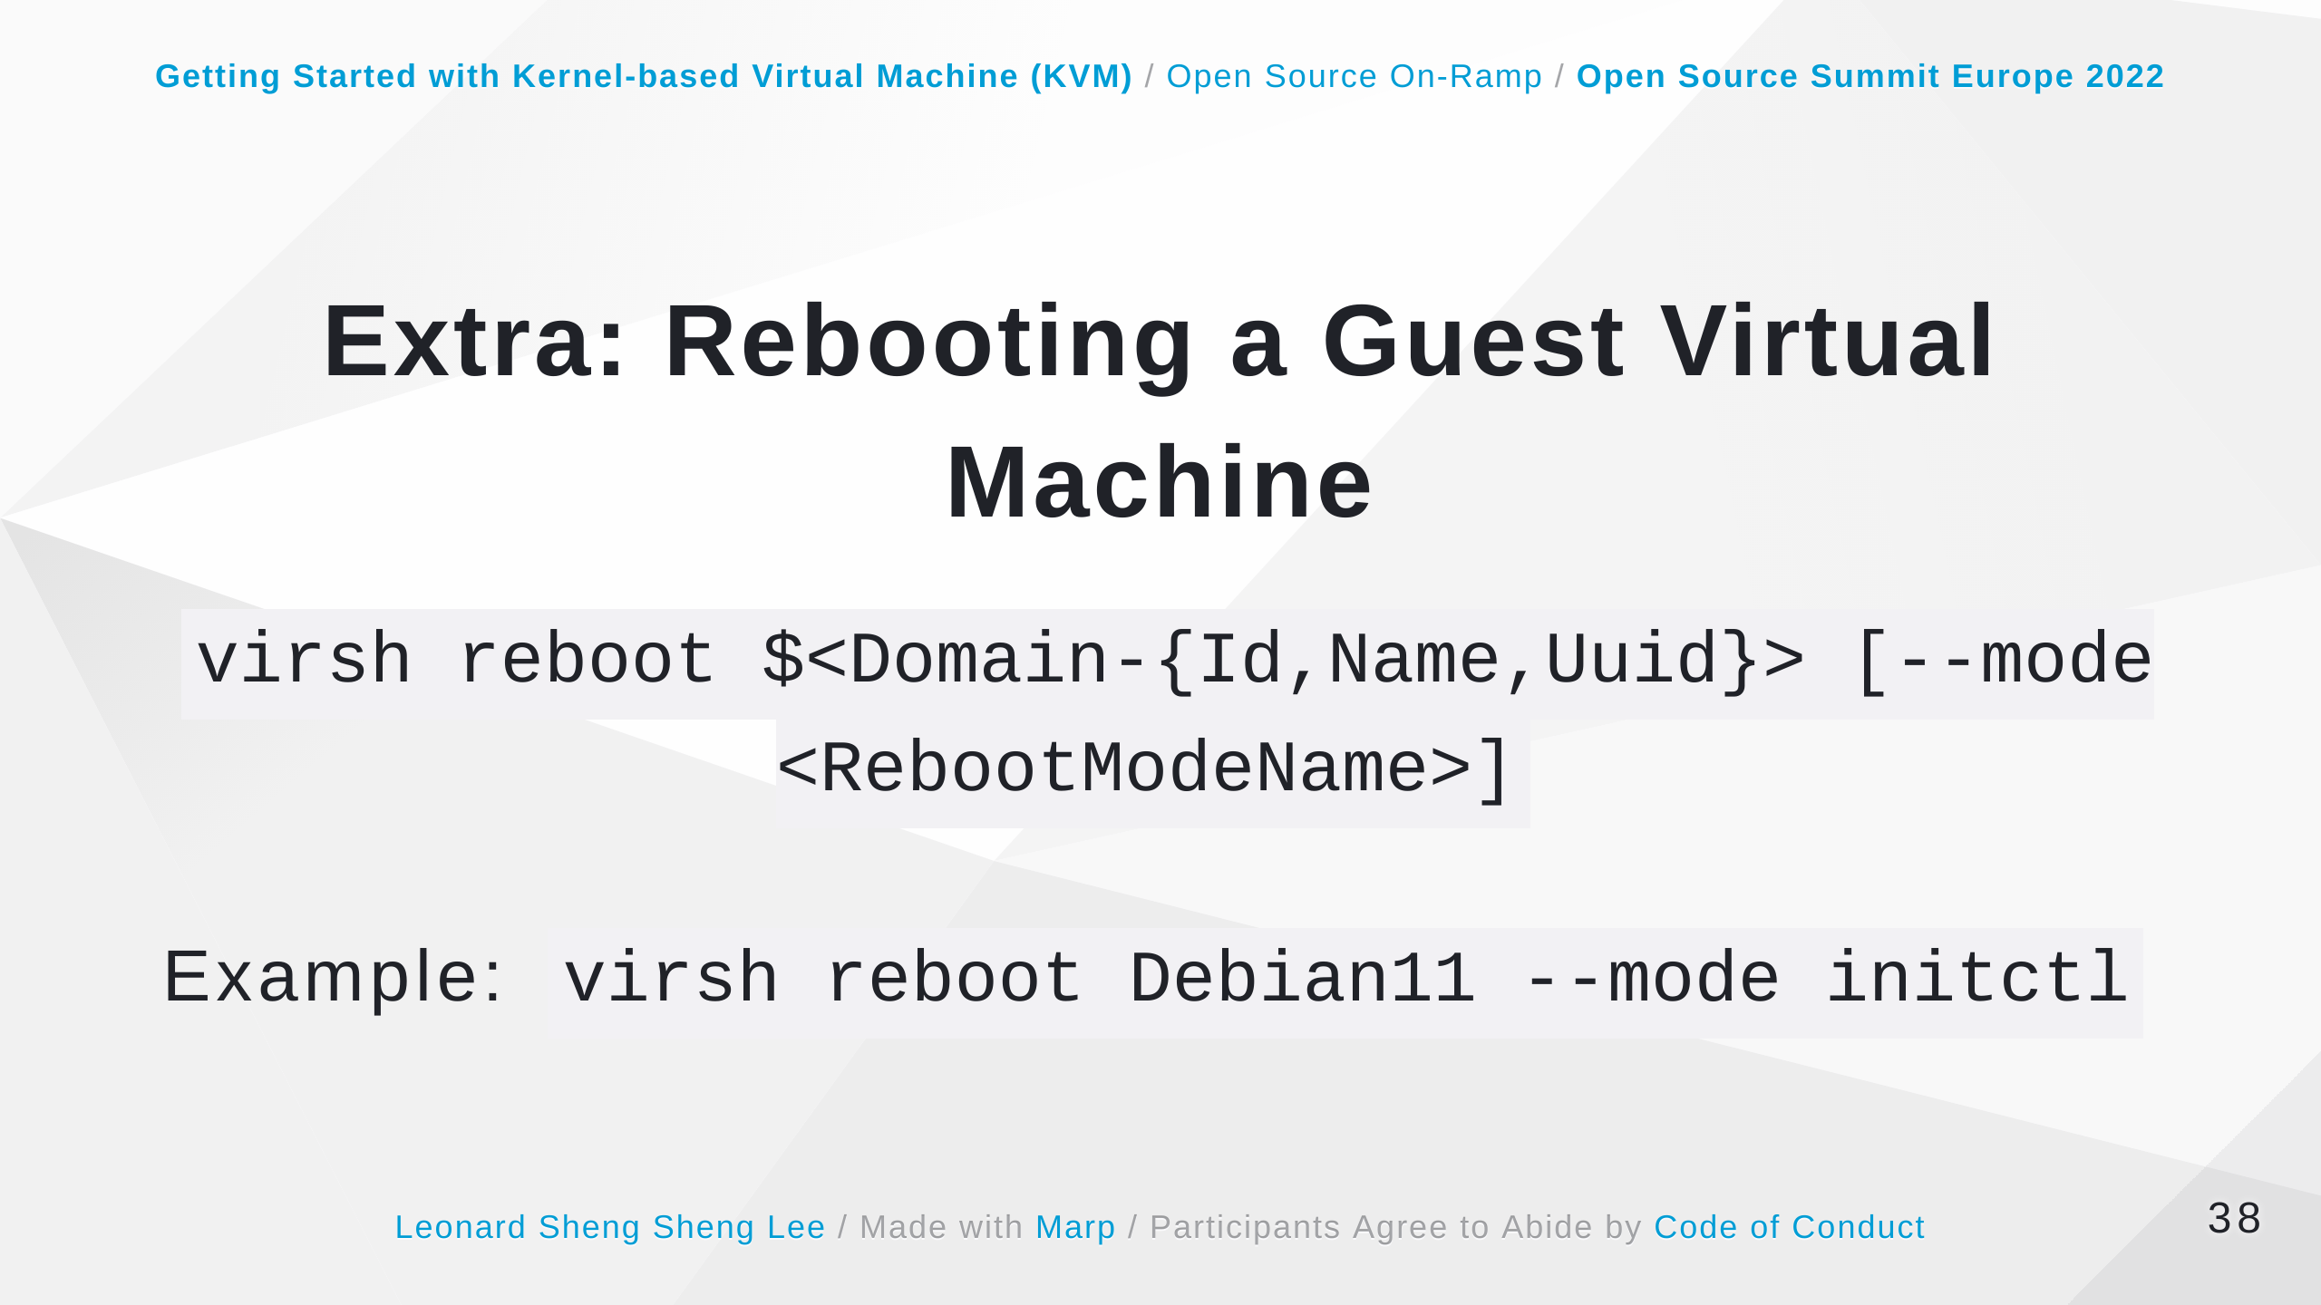
Notes:
Some speaker notes here that might be useful. Remember that this action will only return once it has executed the reboot, so there may be a time lapse from that point until the guest virtual machine actually reboots. You can control the behavior of the rebooting guest virtual machine by modifying the on_reboot element in the guest virtual machine's XML configuration file. By default, the hypervisor attempts to select a suitable shutdown method automatically. To specify an alternative method, the --mode argument can specify a comma separated list which includes acpi and agent. The order in which drivers will try each mode is undefined, and not related to the order specified in virsh. For strict control over ordering, use a single mode at a time and repeat the command. https://access.redhat.com/documentation/en-us/red_hat_enterprise_linux/7/html/virtualization_deployment_and_administration_guide/sect-starting_suspending_resuming_saving_and_restoring_a_guest_virtual_machine-starting_a_defined_domain#sect-Shutting_down_rebooting_and_force_shutdown_of_a_guest_virtual_machine-Rebooting_a_guest_virtual_machine

Slide 39
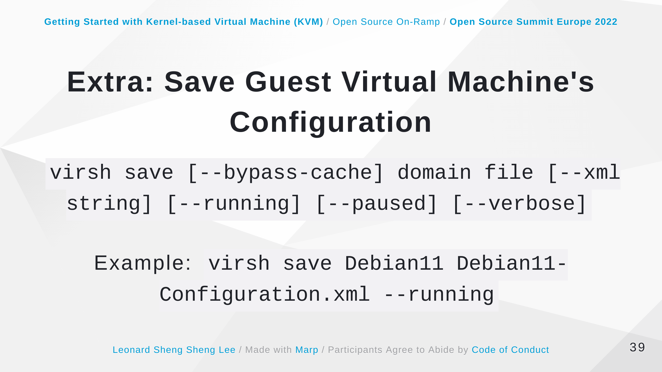
Notes:
Some speaker notes here that might be useful. command stops the specified domain, saving the current state of the guest virtual machine's system memory to a specified file. This may take a considerable amount of time, depending on the amount of memory in use by the guest virtual machine. You can restore the state of the guest virtual machine with the virsh restore command. The difference between the virsh save command and the virsh suspend command, is that the virsh suspend stops the domain CPUs, but leaves the domain's qemu process running and its memory image resident in the host system. This memory image will be lost if the host system is rebooted. The virsh save command stores the state of the domain on the hard disk of the host system and terminates the qemu process. This enables restarting the domain from the saved state. You can monitor the process of virsh save with the virsh domjobinfo command and cancel it with the virsh domjobabort command. The virsh save command can take the following arguments: --bypass-cache - causes the restore to avoid the file system cache but note that using this flag may slow down the restore operation. --xml - this argument must be used with an XML file name. Although this argument is usually omitted, it can be used to supply an alternative XML file for use on a restored guest virtual machine with changes only in the host-specific portions of the domain XML. For example, it can be used to account for the file naming differences in underlying storage due to disk snapshots taken after the guest was saved. --running - overrides the state recorded in the save image to start the guest virtual machine as running. --paused - overrides the state recorded in the save image to start the guest virtual machine as paused. --verbose - displays the progress of the save. https://access.redhat.com/documentation/en-us/red_hat_enterprise_linux/7/html/virtualization_deployment_and_administration_guide/sect-save-config#sect-Starting_suspending_resuming_saving_and_restoring_a_guest_virtual_machine-Save_a_guest_virtual_machine

Slide 40
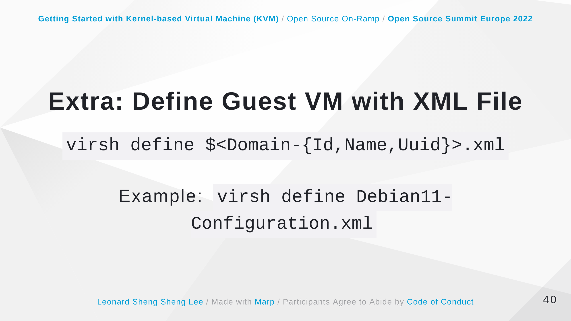
Notes:
Some speaker notes here that might be useful. This command defines a guest virtual machine from an XML file. The guest virtual machine definition in this case is registered but not started. If the guest virtual machine is already running, the changes the changes will take effect once the domain is shut down and started again.

Slide 41
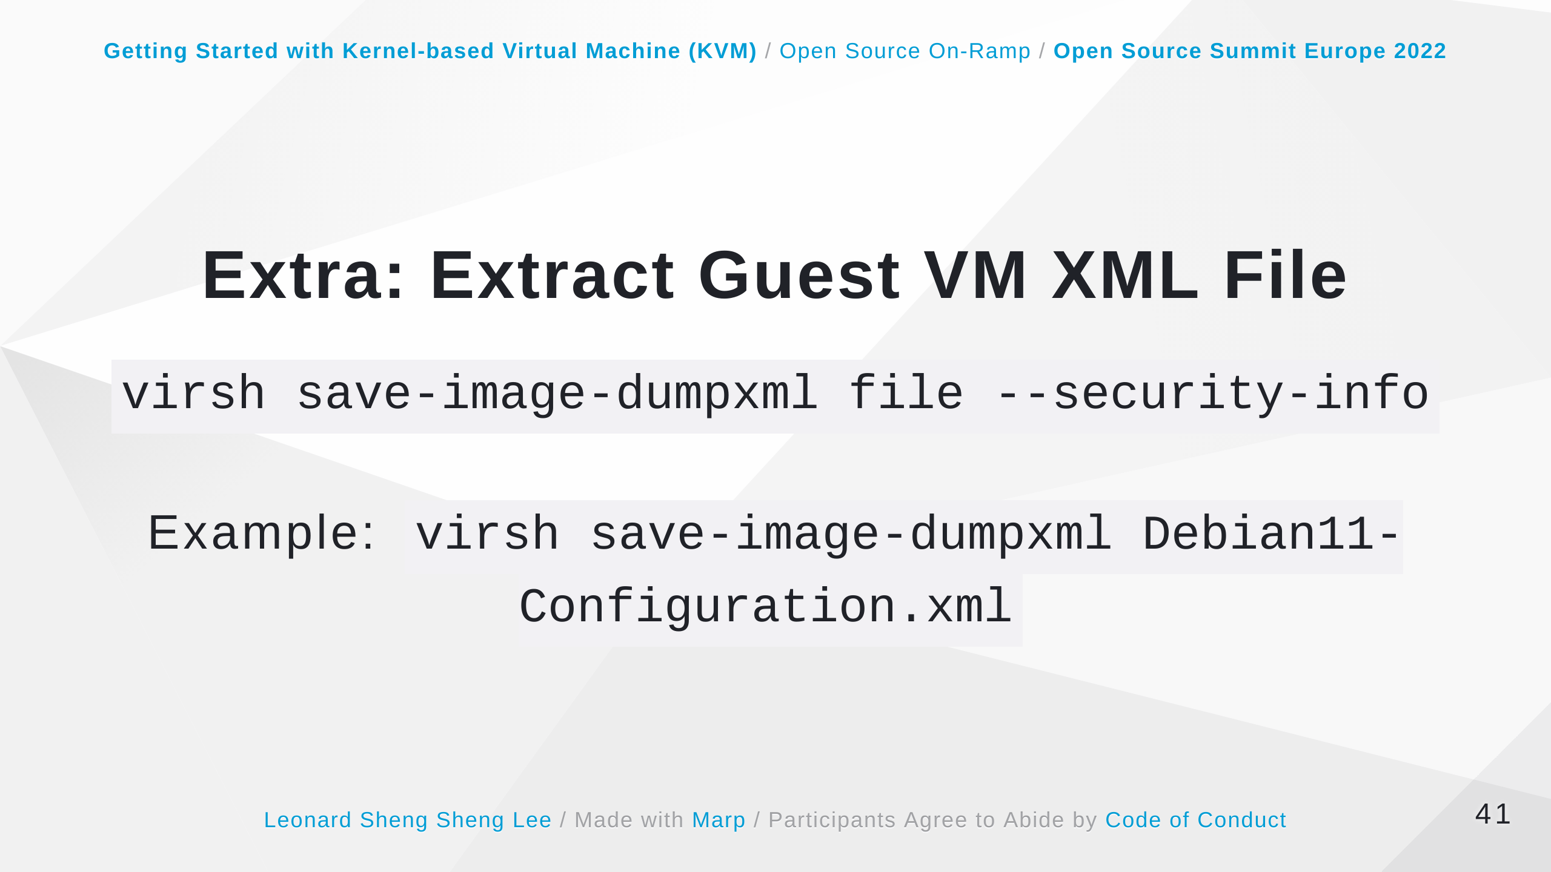
Notes:
Some speaker notes here that might be useful. The command will extract the guest virtual machine XML file that was in effect at the time the saved state file (used in the virsh save command) was referenced. Using the --security-info argument includes security sensitive information in the file. https://access.redhat.com/documentation/en-us/red_hat_enterprise_linux/7/html/virtualization_deployment_and_administration_guide/sect-save-config#sect-Starting_suspending_resuming_saving_and_restoring_a_guest_virtual_machine-Extracting_the_domain_XML_file

Slide 42
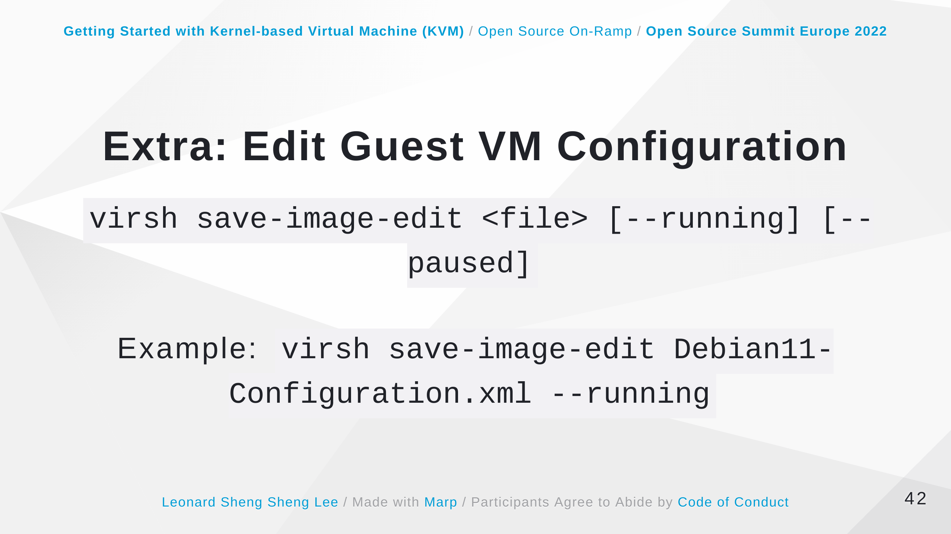
Notes:
Some speaker notes here that might be useful. The command edits the XML configuration file that was created by the virsh save command. When the guest virtual machine is saved, the resulting image file will indicate if the virtual machine should be restored to a --running or --paused state. Without using these arguments in the save-image-edit command, the state is determined by the image file itself. By selecting --running (to select the running state) or --paused (to select the paused state) you can overwrite the state that virsh restore should use. https://access.redhat.com/documentation/en-us/red_hat_enterprise_linux/7/html/virtualization_deployment_and_administration_guide/sect-save-config#sect-Starting_suspending_resuming_saving_and_restoring_a_guest_virtual_machine-Edit_Domain_XML_configuration_files

Slide 43
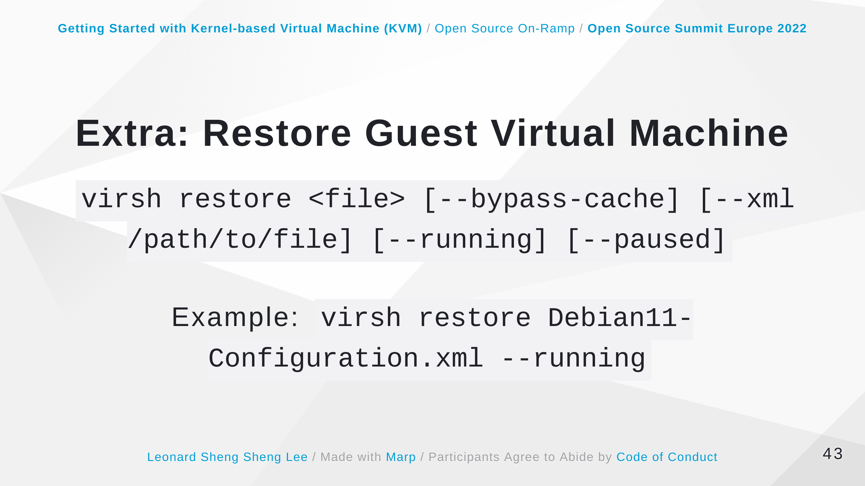
Notes:
Some speaker notes here that might be useful. The command restores a guest virtual machine previously saved with the virsh save command. The restore action restarts the saved guest virtual machine, which may take some time. The guest virtual machine's name and UUID are preserved, but the ID will not necessarily match the ID that the virtual machine had when it was saved. The virsh restore command can take the following arguments: --bypass-cache - causes the restore to avoid the file system cache but note that using this flag may slow down the restore operation. --xml - this argument must be used with an XML file name. Although this argument is usually omitted, it can be used to supply an alternative XML file for use on a restored guest virtual machine with changes only in the host-specific portions of the domain XML. For example, it can be used to account for the file naming differences in underlying storage due to disk snapshots taken after the guest was saved. --running - overrides the state recorded in the save image to start the guest virtual machine as running. --paused - overrides the state recorded in the save image to start the guest virtual machine as paused. https://access.redhat.com/documentation/en-us/red_hat_enterprise_linux/7/html/virtualization_deployment_and_administration_guide/sect-starting_suspending_resuming_saving_and_restoring_a_guest_virtual_machine-starting_a_defined_domain#sect-Starting_suspending_resuming_saving_and_restoring_a_guest_virtual_machine-Restore_a_guest_virtual_machine

Slide 44
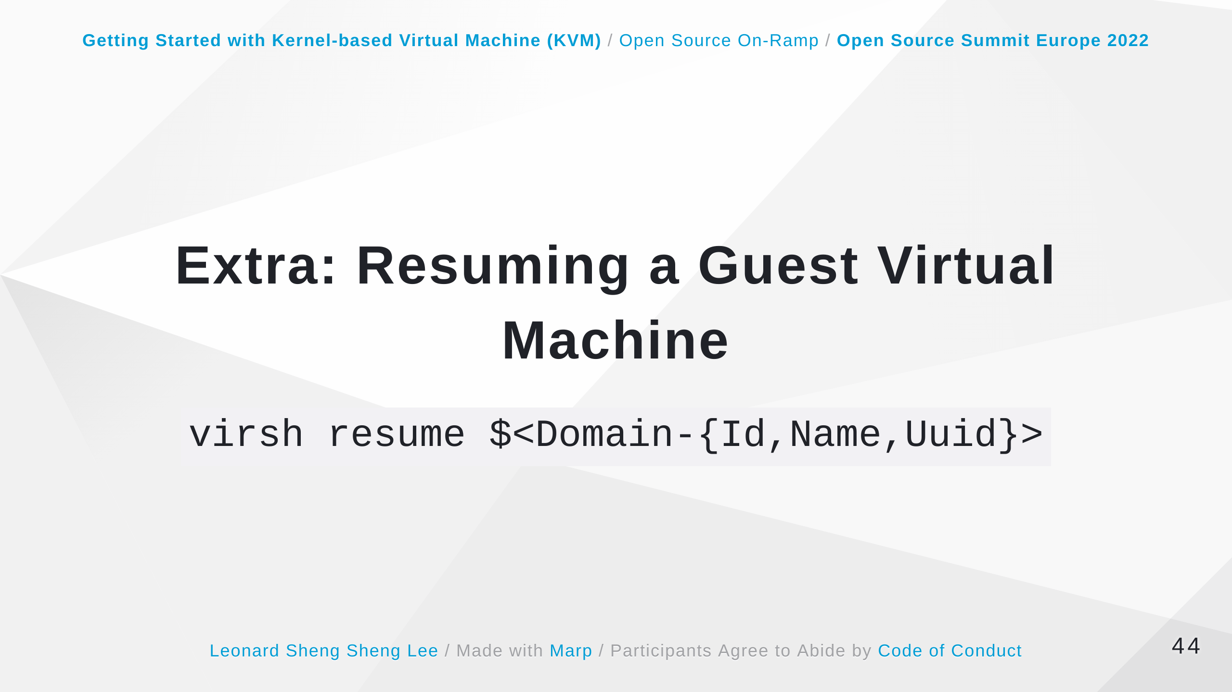
Notes:
Some speaker notes here that might be useful. The command restarts the CPUs of a domain that was suspended. This operation is immediate. The guest virtual machine resumes execution from the point it was suspended. Note that this action will not resume a guest virtual machine that has been undefined. This action will not resume transient virtual machines and will only work on persistent virtual machines. https://access.redhat.com/documentation/en-us/red_hat_enterprise_linux/7/html/virtualization_deployment_and_administration_guide/sect-starting_suspending_resuming_saving_and_restoring_a_guest_virtual_machine-starting_a_defined_domain#sect-Starting_suspending_resuming_saving_and_restoring_a_guest_virtual_machine-Resuming_a_guest_virtual_machine

Slide 45
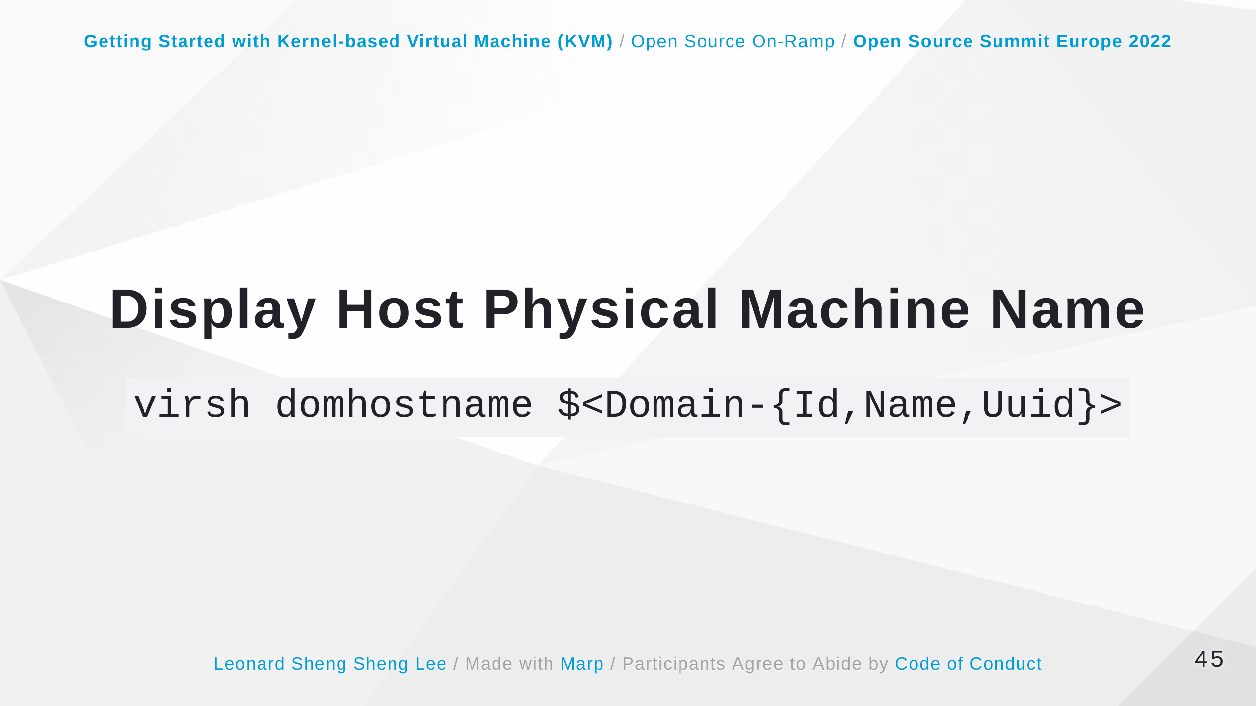
Notes:
Some speaker notes here that might be useful. https://access.redhat.com/documentation/en-us/red_hat_enterprise_linux/7/html/virtualization_deployment_and_administration_guide/sect-generic_commands-version

Slide 46
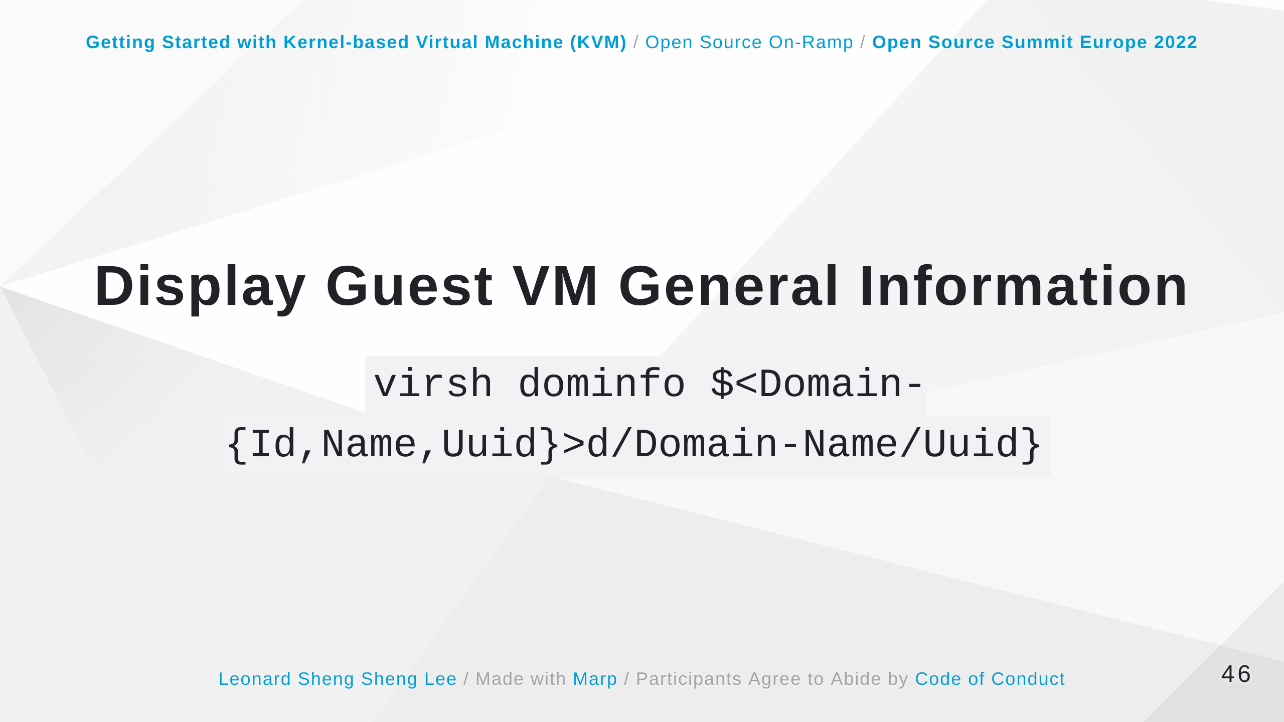
Notes:
Some speaker notes here that might be useful. https://access.redhat.com/documentation/en-us/red_hat_enterprise_linux/7/html/virtualization_deployment_and_administration_guide/sect-domain_commands-domain_retrieval_commands#sect-virshdominfo

Slide 47
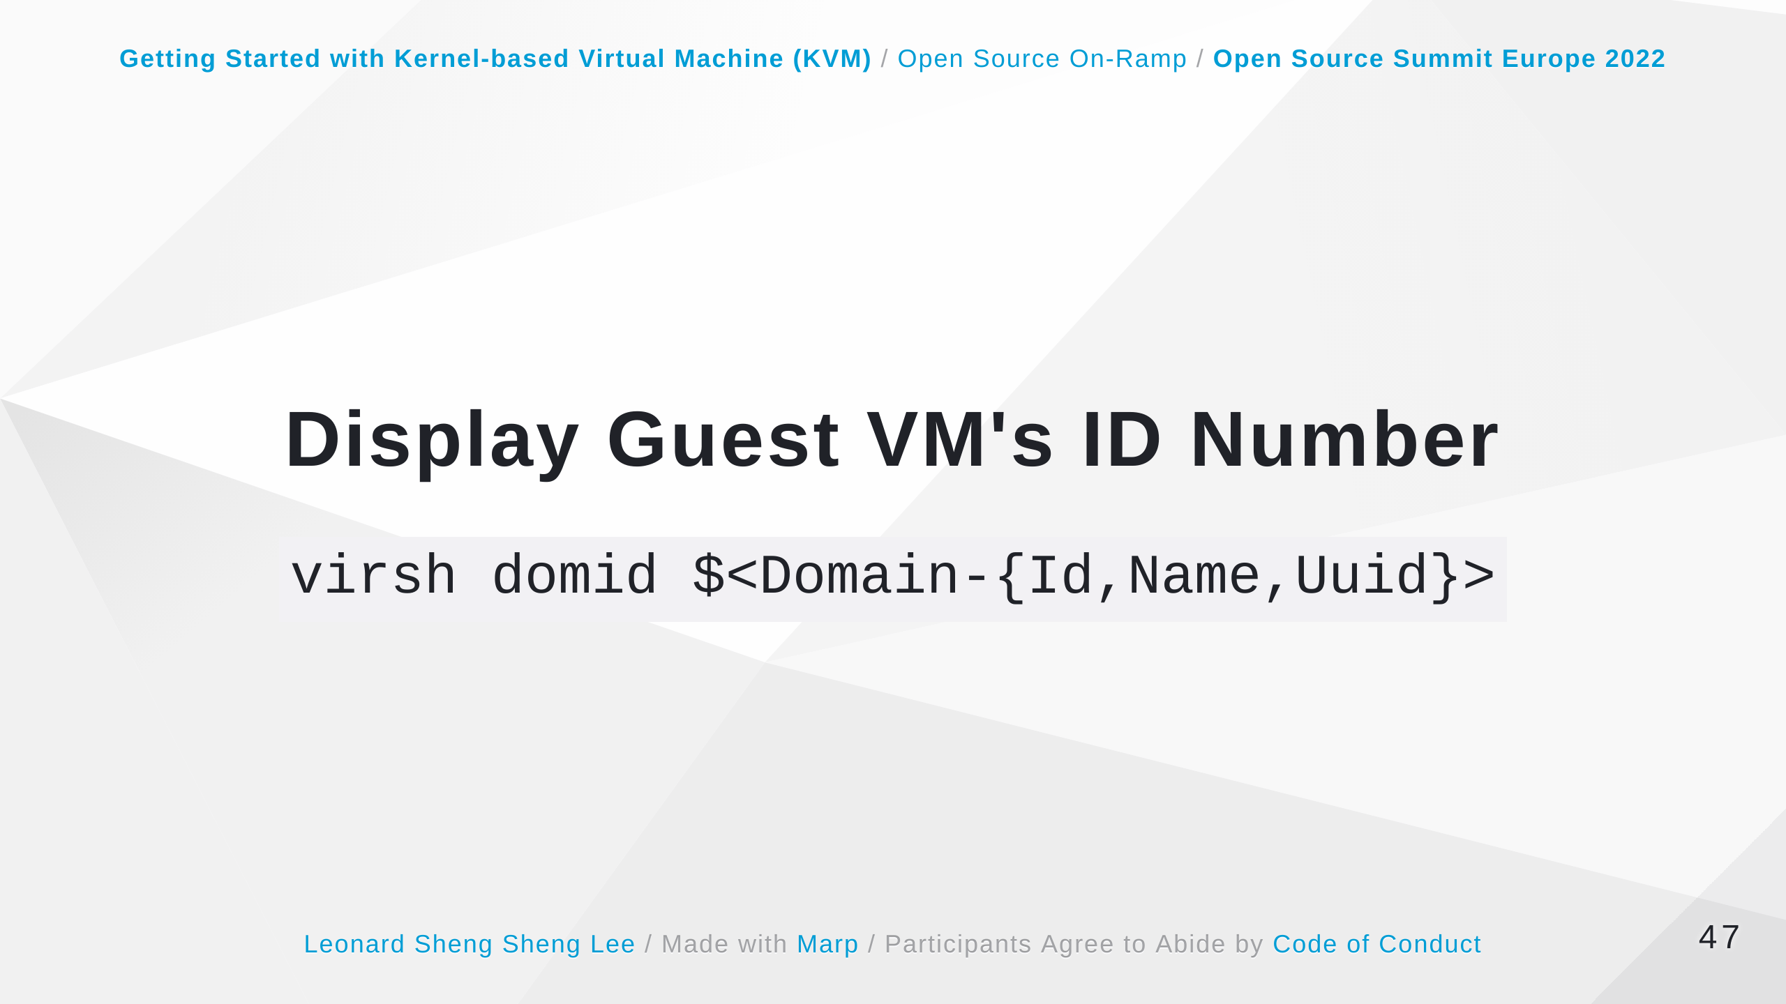
Notes:
Some speaker notes here that might be useful. https://access.redhat.com/documentation/en-us/red_hat_enterprise_linux/7/html/virtualization_deployment_and_administration_guide/sect-domain_commands-domain_retrieval_commands#sect-virsh-domid

Slide 48
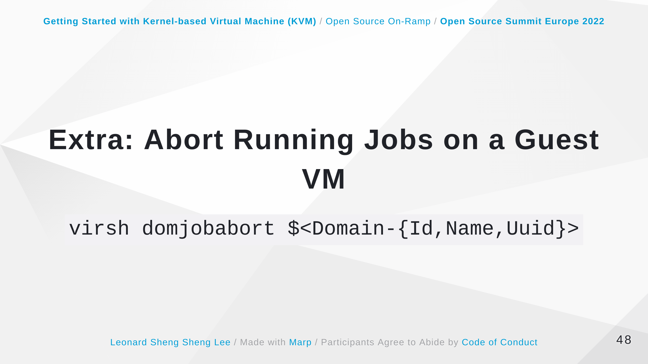
Notes:
Some speaker notes here that might be useful. https://access.redhat.com/documentation/en-us/red_hat_enterprise_linux/7/html/virtualization_deployment_and_administration_guide/sect-domain_commands-domain_retrieval_commands#virsh-domjobabort

Slide 49
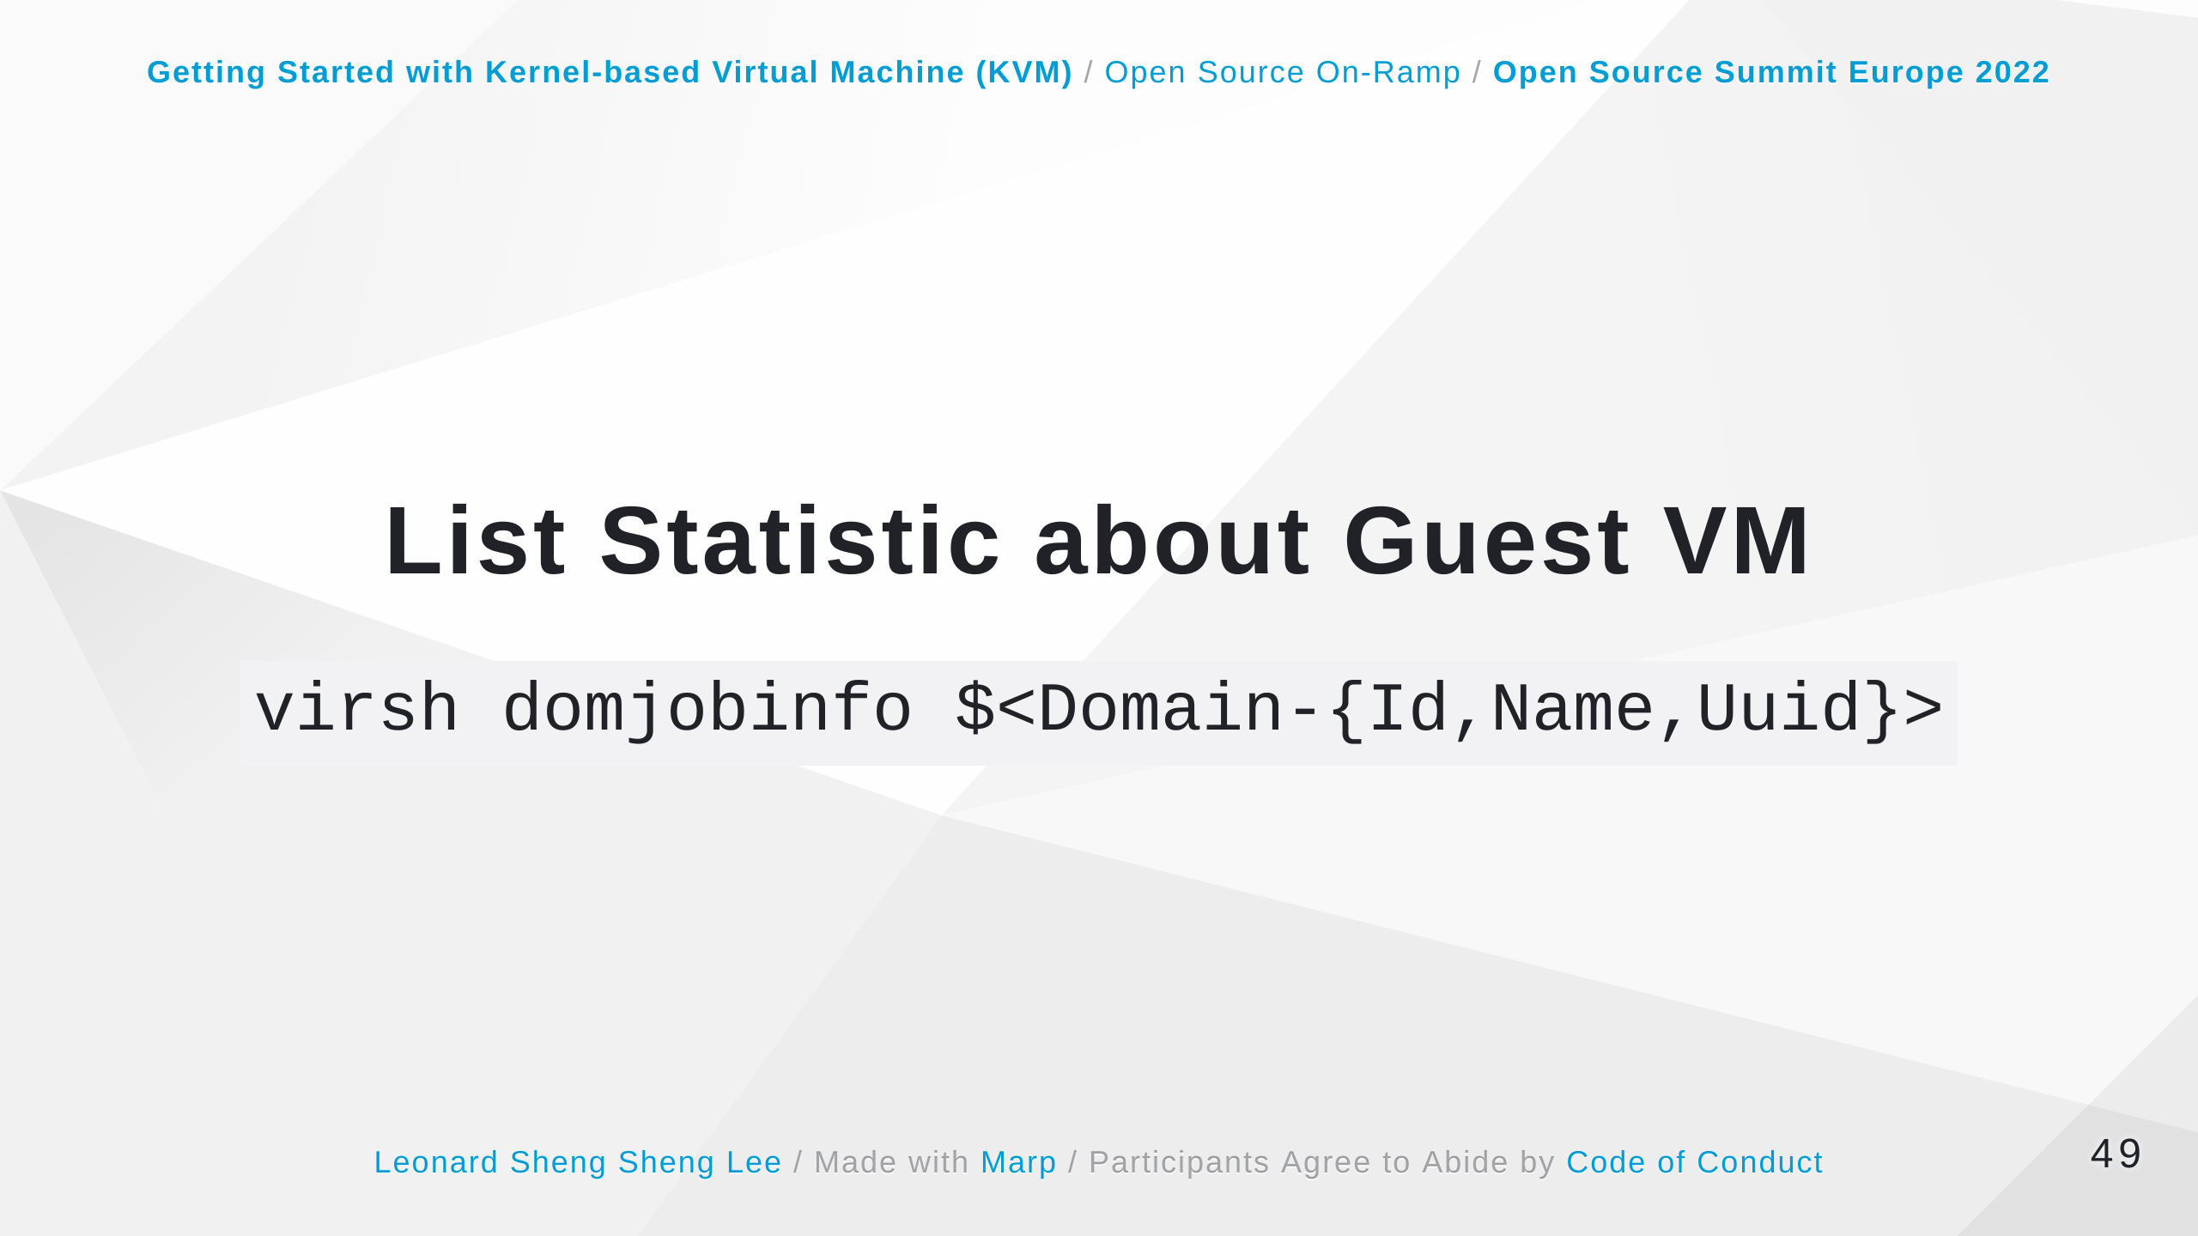
Notes:
Some speaker notes here that might be useful. https://access.redhat.com/documentation/en-us/red_hat_enterprise_linux/7/html/virtualization_deployment_and_administration_guide/sect-domain_commands-domain_retrieval_commands#virsh-domjobinfo

Slide 50
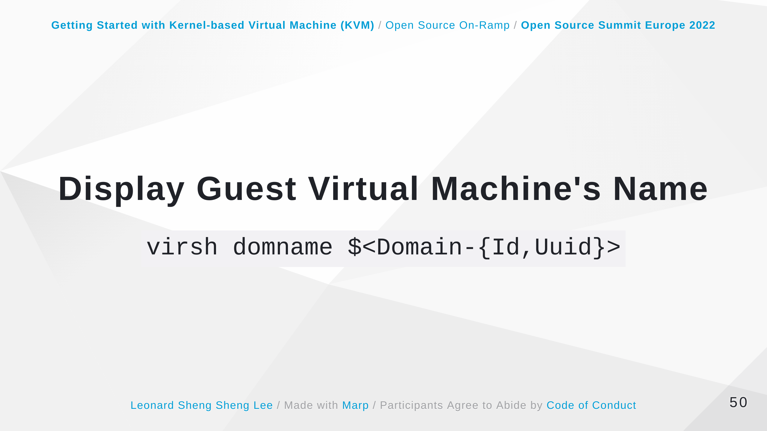
Notes:
Some speaker notes here that might be useful. https://access.redhat.com/documentation/en-us/red_hat_enterprise_linux/7/html/virtualization_deployment_and_administration_guide/sect-domain_commands-domain_retrieval_commands#sect-virsh-domname

Slide 51
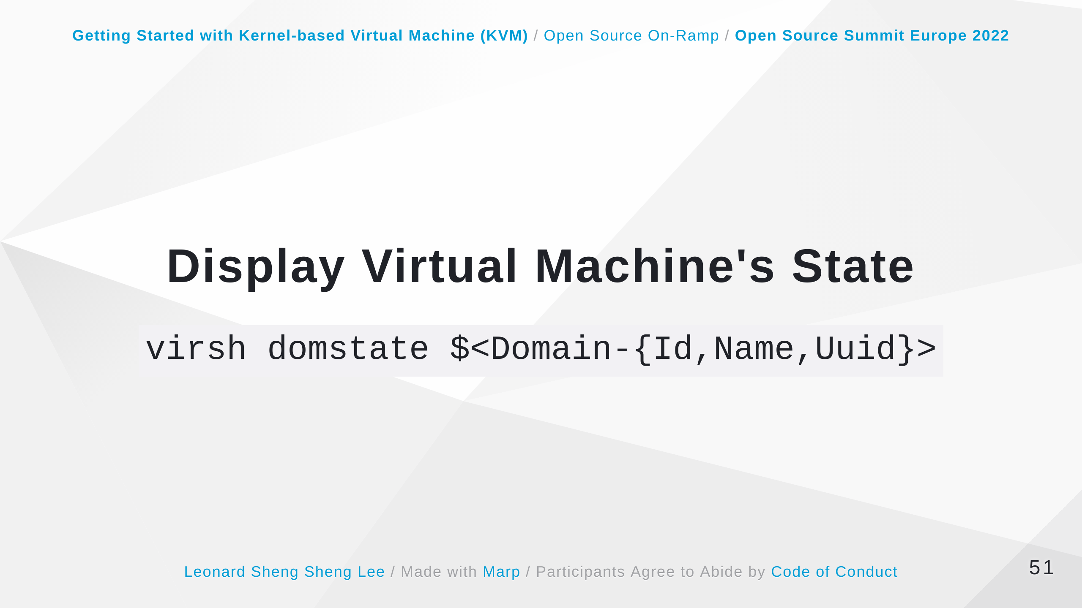
Notes:
Some speaker notes here that might be useful. https://access.redhat.com/documentation/en-us/red_hat_enterprise_linux/7/html/virtualization_deployment_and_administration_guide/sect-domain_commands-domain_retrieval_commands#sect-virsh-domstate

Slide 52

Notes:
Some speaker notes here that might be useful. https://access.redhat.com/documentation/en-us/red_hat_enterprise_linux/7/html/virtualization_deployment_and_administration_guide/sect-domain_commands-domain_retrieval_commands#sect-virsh-domcontrol

Slide 53

Notes:
Some speaker notes here that might be useful. The command shuts down a guest virtual machine. You can control the behavior of how the guest virtual machine reboots by modifying the on_shutdown parameter in the guest virtual machine's configuration file. Any change to the on_shutdown parameter will only take effect after the domain has been shutdown and restarted. The virsh shutdown command command can take the following optional argument: --mode chooses the shutdown mode. This can be either acpi, agent, initctl, signal, or paravirt. https://access.redhat.com/documentation/en-us/red_hat_enterprise_linux/7/html/virtualization_deployment_and_administration_guide/sect-managing_guest_virtual_machines_with_virsh-shutting_down_rebooting_and_force_shutdown_of_a_guest_virtual_machine#sect-Shutting_down_rebooting_and_force_shutdown_of_a_guest_virtual_machine-Shut_down_a_guest_virtual_machine

Slide 54

Notes:
Some speaker notes here that might be useful. When a guest virtual machine is in a suspended state, it consumes system RAM but not processor resources. Disk and network I/O does not occur while the guest virtual machine is suspended. This operation is immediate and the guest virtual machine can only be restarted with the virsh resume command. Running this command on a transient virtual machine will delete it. https://access.redhat.com/documentation/en-us/red_hat_enterprise_linux/7/html/virtualization_deployment_and_administration_guide/sect-managing_guest_virtual_machines_with_virsh-shutting_down_rebooting_and_force_shutdown_of_a_guest_virtual_machine#sect-Starting_suspending_resuming_saving_and_restoring_a_guest_virtual_machine-Suspending_a_guest_virtual_machine

Slide 55

Notes:
Some speaker notes here that might be useful. The command resets the guest virtual machine immediately without any guest shutdown. A reset emulates the reset button on a machine, where all guest hardware sees the RST line and re-initializes the internal state. Note that without any guest virtual machine OS shutdown, there are risks for data loss. Resetting a virtual machine does not apply any pending domain configuration changes. Changes to the domain's configuration only take effect after a complete shutdown and restart of the domain. https://access.redhat.com/documentation/en-us/red_hat_enterprise_linux/7/html/virtualization_deployment_and_administration_guide/sect-managing_guest_virtual_machines_with_virsh-shutting_down_rebooting_and_force_shutdown_of_a_guest_virtual_machine#sect-Starting_suspending_resuming_saving_and_restoring_a_guest_virtual_machine-Suspending_a_guest_virtual_machine

Slide 56

Notes:
Some speaker notes here that might be useful. The command saves and destroys (stops) a running guest virtual machine so that it can be restarted from the same state at a later time. When used with a virsh start command it is automatically started from this save point. If it is used with the --bypass-cache argument the save will avoid the filesystem cache. Note that this option may slow down the save process speed and using the --verbose option displays the progress of the dump process. Under normal conditions, the managed save will decide between using the running or paused state as determined by the state the guest virtual machine is in when the save is done. However, this can be overridden by using the --running option to indicate that it must be left in a running state or by using --paused option which indicates it is to be left in a paused state. To remove the managed save state, use the virsh managedsave-remove command which will force the guest virtual machine to do a full boot the next time it is started. Note that the entire managed save process can be monitored using the domjobinfo command and can also be canceled using the domjobabort command. https://access.redhat.com/documentation/en-us/red_hat_enterprise_linux/7/html/virtualization_deployment_and_administration_guide/sect-managing_guest_virtual_machines_with_virsh-shutting_down_rebooting_and_force_shutdown_of_a_guest_virtual_machine#sect-Starting_suspending_resuming_saving_and_restoring_a_guest_virtual_machine-Suspending_a_guest_virtual_machine

Slide 57

Notes:
Some speaker notes here that might be useful. The qemu-img command-line tool is used for formatting, modifying, and verifying various file systems used by KVM. https://access.redhat.com/documentation/en-us/red_hat_enterprise_linux/7/html/virtualization_deployment_and_administration_guide/chap-using_qemu_img Using different parameters from the qemu-img snapshot command you can list, apply, create, or delete an existing snapshot (snapshot) of specified image (filename). The accepted arguments are as follows: -l lists all snapshots associated with the specified disk image. The apply option, -a, reverts the disk image (filename) to the state of a previously saved snapshot. -c creates a snapshot (snapshot) of an image (filename). -d deletes the specified snapshot. https://access.redhat.com/documentation/en-us/red_hat_enterprise_linux/7/html/virtualization_deployment_and_administration_guide/sect-using_qemu_img-listing_creating_applying_and_deleting_a_snapshot https://access.redhat.com/documentation/en-us/red_hat_enterprise_linux/7/html/virtualization_deployment_and_administration_guide/sect-using_qemu_img-supported_qemu_img_formats

Slide 58

Notes:
Some speaker notes here that might be useful. The command undefines a domain. If domain is inactive, the configuration is removed completely. If the domain is active (running), it is converted to a transient domain. When the guest virtual machine becomes inactive, the configuration is removed completely. This command can take the following arguments: --managed-save - this argument guarantees that any managed save image is also cleaned up. Without using this argument, attempts to undefine a guest virtual machine with a managed save will fail. --snapshots-metadata - this argument guarantees that any snapshots (as shown with snapshot-list) are also cleaned up when undefining an inactive guest virtual machine. Note that any attempts to undefine an inactive guest virtual machine with snapshot metadata will fail. If this argument is used and the guest virtual machine is active, it is ignored. --storage - using this argument requires a comma separated list of volume target names or source paths of storage volumes to be removed along with the undefined domain. This action will undefine the storage volume before it is removed. Note that this can only be done with inactive guest virtual machines and that this will only work with storage volumes that are managed by libvirt. --remove-all-storage - in addition to undefining the guest virtual machine, all associated storage volumes are deleted. If you want to delete the virtual machine, choose this option only if there are no other virtual machines using the same associated storage. An alternative way is with the virsh vol-delete. --wipe-storage - in addition to deleting the storage volume, the contents are wiped. https://access.redhat.com/documentation/en-us/red_hat_enterprise_linux/7/html/virtualization_deployment_and_administration_guide/sect-virsh-delete

Slide 59

Notes:
Some speaker notes here that might be useful. The command initiates an immediate ungraceful shutdown and stops the specified guest virtual machine. Using virsh destroy can corrupt guest virtual machine file systems. Use the virsh destroy command only when the guest virtual machine is unresponsive. The virsh destroy command with the --graceful option attempts to flush the cache for the disk image file before powering off the virtual machine. https://access.redhat.com/documentation/en-us/red_hat_enterprise_linux/7/html/virtualization_deployment_and_administration_guide/sect-virsh-delete

Slide 60


Slide 61


Slide 62


Slide 63


Slide 64

Notes:
Some speaker notes here that might be useful. Opens an interactive console that you can use to manually install the guest virtual machine.

Slide 65


Slide 66

Notes:
Some speaker notes here that might be useful. https://download.fedoraproject.org/pub/fedora/linux/releases/36/Server/x86_64/os Opens an interactive console that you can use to manually install the guest virtual machine.

Slide 67


Slide 68

Notes:
Some speaker notes here that might be useful. https://mirrors.almalinux.org/isos/x86_64/9.0.html https://almalinux.uib.no/9.0/isos/x86_64/ https://almalinux.uib.no/9.0/BaseOS/x86_64/os/ Opens an interactive console that you can use to manually install the guest virtual machine.

Slide 69


Slide 70

Notes:
Some speaker notes here that might be useful. https://www.centos.org/download/mirrors/ https://admin.fedoraproject.org/mirrormanager/mirrors/CentOS https://mirror.netsite.dk/centos-stream/9-stream/BaseOS/x86_64/os/ Opens an interactive console that you can use to manually install the guest virtual machine.

Slide 71


Slide 72

Notes:
Some speaker notes here that might be useful. MTU means Maximum Transmission Unit.

Slide 73

Notes:
Some speaker notes here that might be useful. EDD means BIOS Enhanced Disk Device Services (EDD)

Slide 74


Slide 75


Slide 76

Notes:
Some speaker notes here that might be useful. https://blog.programster.org/kvm-missing-default-network

Slide 77


Slide 78


Slide 79


Slide 80


Slide 81


Slide 82


Slide 83


Slide 84


Slide 85


Slide 86


Slide 87


Slide 88


Slide 89


Slide 90


Slide 91


Slide 92


Slide 93


Slide 94


Slide 95


Slide 96


Slide 97


Slide 98


Slide 99


Slide 100


Slide 101


Slide 102


Slide 103


Slide 104


Slide 105


Slide 106


Slide 107


Slide 108


Slide 109


Slide 110


Slide 111


Slide 112


Slide 113


Slide 114


Slide 115


Slide 116


Slide 117


Slide 118


Slide 119


Slide 120


Slide 121


Slide 122


Slide 123


Slide 124


Slide 125


Slide 126


Slide 127


Slide 128


Slide 129


Slide 130


Slide 131


Slide 132


Slide 133


Slide 134


Slide 135


Slide 136


Slide 137


Slide 138


Slide 139


Slide 140


Slide 141


Slide 142


Slide 143


Slide 144


Slide 145


Slide 146


Slide 147


Slide 148


Slide 149


Slide 150


Slide 151


Slide 152


Slide 153


Slide 154


Slide 155

Notes:
Some speaker notes here that might be useful. Hints: https://github.com/sheeeng/debian-vm-install/tree/debian10 https://github.com/sheeeng/kickstart-fedora-workstation

Slide 156

Notes:
## Bonus: Bridged Networking - The standard [NAT forwarding (aka. "default virtual network")](https://wiki.libvirt.org/page/Networking#NAT_forwarding_.28aka_.22virtual_networks.22.29) based connectivity is useful for quick & easy deployments, or on machines with dynamic/sporadic networking connectivity. Advanced users will want to use [Bridged networking (aka. "shared physical device")](https://wiki.libvirt.org/page/Networking#Bridged_networking_.28aka_.22shared_physical_device.22.29), where the guest is connected directly to the LAN. - Some speaker notes here that might be useful. ```console $ sudo virsh net-dumpxml default <network> <name>default</name> <uuid>258ae95f-f434-45e8-aa8c-09fb2d9735d0</uuid> <forward mode='nat'> <nat> <port start='1024' end='65535'/> </nat> </forward> <bridge name='virbr0' stp='on' delay='0'/> <mac address='52:54:00:a8:72:47'/> <ip address='192.168.122.1' netmask='255.255.255.0'> <dhcp> <range start='192.168.122.2' end='192.168.122.254'/> </dhcp> </ip> </network> ```

Slide 157


Slide 158


